Slide 1
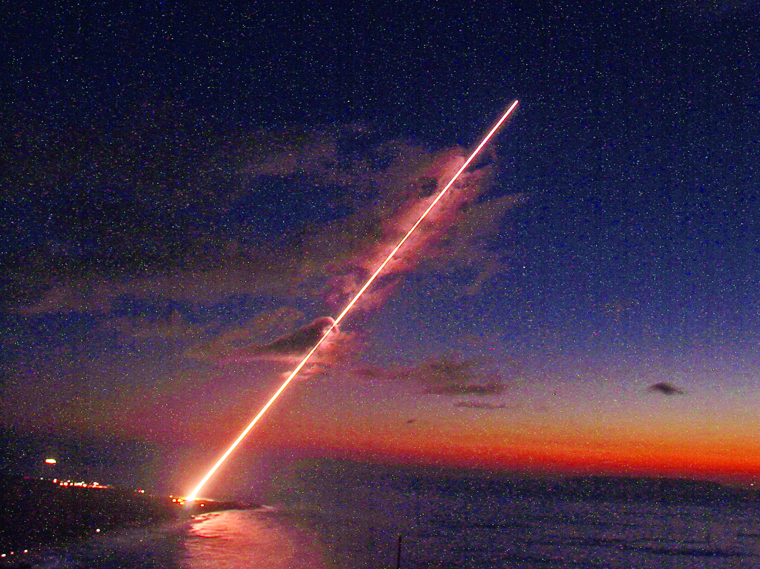
THAAD
Andrew Wrist

Slide 2
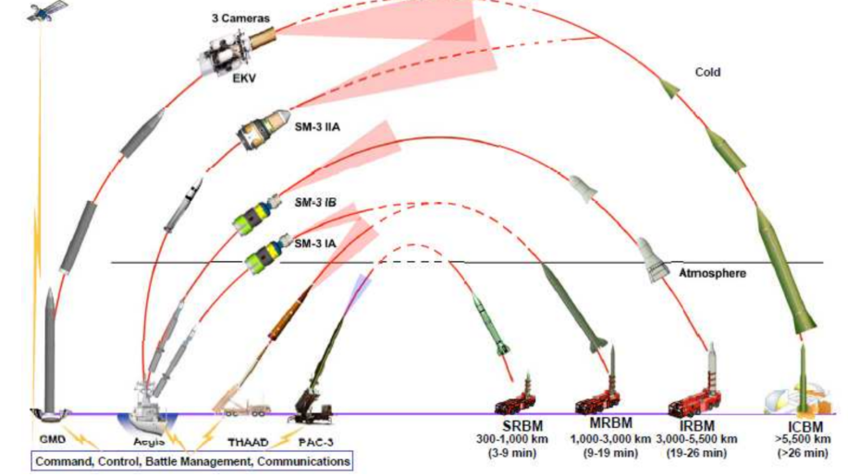
Missile Defense

Slide 3
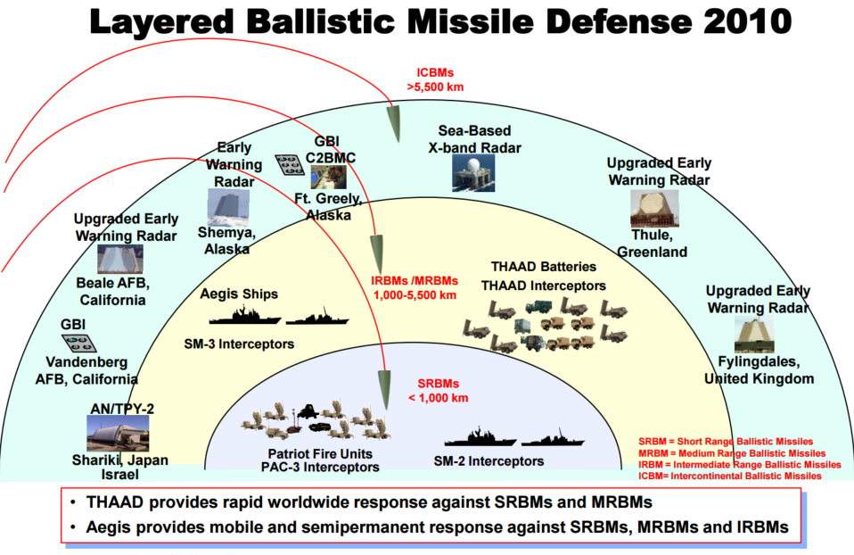

Slide 4
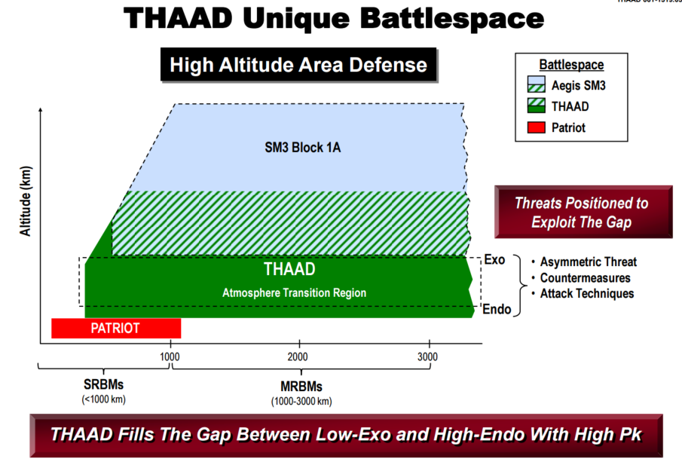

Slide 5
What is THAAD?
Terminal High Altitude Area Defense program
Primary contractor: Lockheed Martin Space Systems
Provides Ballistic Missile Defense System (BMDS) with:
Global transportability
Rapid deployment
Ability to intercept ballistic missiles inside or outside of atmosphere during terminal phase of flight

Slide 6
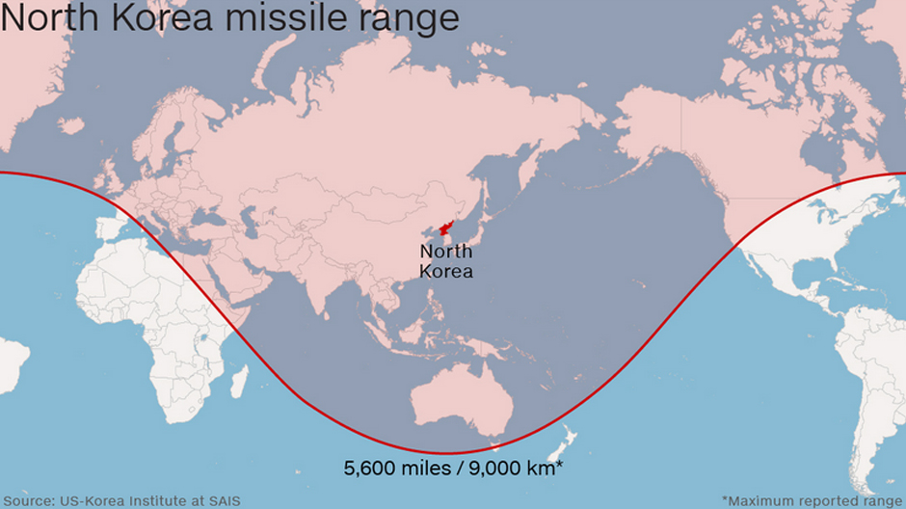
Deployment
June, 2009: Hawaii
December, 2011: United Arab Emirates (announced deal)
April, 2013: Guam
May, 2013: Oman (announced deal)
November, 2015: Japan announces plan to consider deployment
March, 2016: Considered THAAD deployments to Europe and Middle East
2016: South Korea in talks
THAAD /24

Slide 7
Short Discovery Channel Clip
https://www.youtube.com/watch?v=69uXXiJan_o

Slide 8
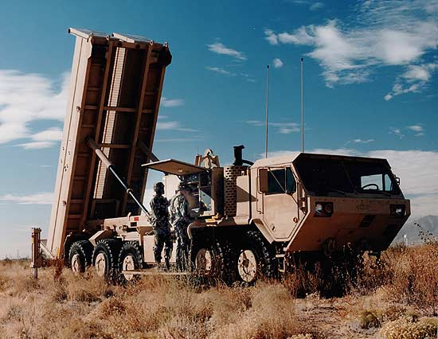
THAAD Battalion
Four batteries
150 missiles each (including both ready to fire and reload)
Nine launchers
One tactical operations center (TOC)
One radar

Slide 9
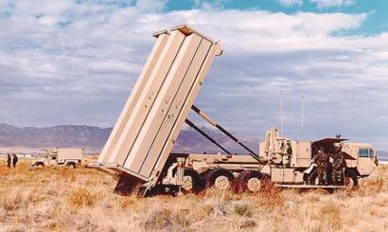
THAAD Build Configuration
5 Components:
Launcher Component
Radar Component
Peculiar Support Equipment (PSE)
THAAD Fire Control and Communications (TFCC) Component
Interceptor Component

Slide 10
Launcher Component
Heavy Expanded Mobility Tactical Truck (HEMTT)-based launcher
8 Interceptors per Launcher
6 Launchers per Battery
30 min reload
Highly mobile

Slide 11
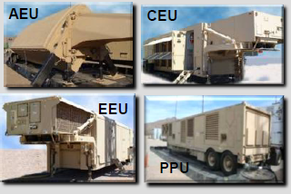
Radar Components
Antenna Equipment Unit (AEU)
Descriminates between threats and non-threats, then tracks threats
Electronic Equipment Unit (EEU)
Cooling Equipment Unit (CEU)
Prime Power Unit (PPU)
Performs surveillance, target tracks, missile track, and in-flight uplink communication.

Slide 12
Peculiar Support Equipment (PSE)

Slide 13
THAAD Fire Control and Communications Component (TFCC)
Tactical Operations Station (TOS)
Force/engagement operations managed from dual tactical operation stations
Launch Control Station (LCS)
Robust communication capabilities

Slide 14
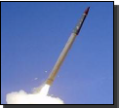
Interceptor Component
Hit-to-Kill lethality (kinetic energy)
Uncooled Sapphire window
Mid-wave infrared gimbaled seeker
Single-stage solid-propellant booster with thrust vector control
Liquid bi-propellant Divert and Attitude Control System (DACS)

Slide 15
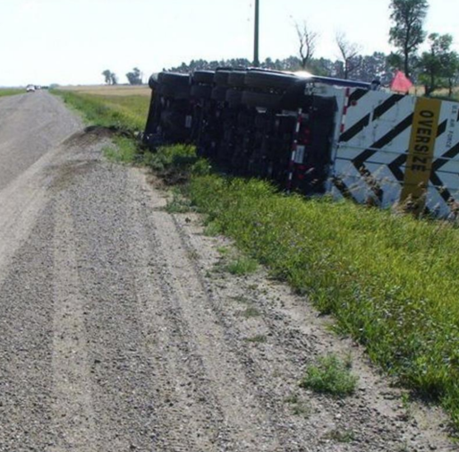
Thermally Initiated Venting System (TIVS)
Solid Rocket motors highly sensitive to chamber pressure to initiate or maintain combustion
“Venting” used to extinguish solid rocket motors if a rise in pressure or temperature inside canister is detected
Valve for vent automatically triggered to open and reduce pressure inside canister
Also used on International Space Station

Slide 16
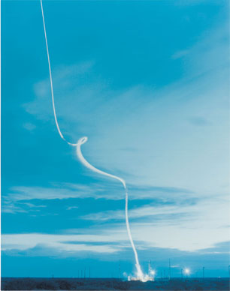
Energy Management Steering
Energy Management Steering maneuver is used to burn excess propellant and reduce speed immediately after leaving canister to remain within range safety constraints
https://www.youtube.com/watch?v=_ObQJnqw0cE start at 40s

Slide 17
Missile Configuration

Slide 18
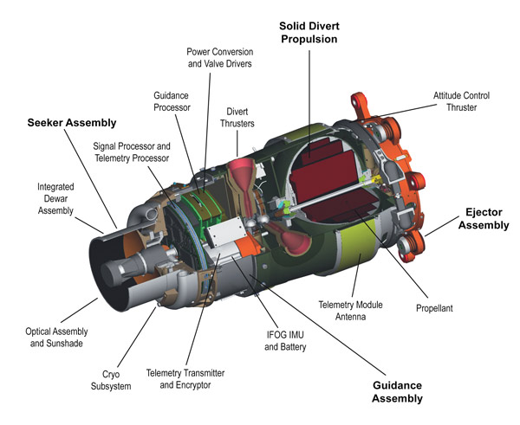
Raytheon Kill Vehicle

Slide 19
Optical Navigation
Also known as Optical Flow
Pattern of apparent motion of objects, surfaces, and edges in visual scene caused by relative motion between an observer and scene
Autonomous uses: UAVs, self driving cars, robots, rockets, landers
http://www.vision.caltech.edu/~eeyjolfs/htmls/navigation.html
Set tracking info
Read Camera/sensors
Navigation: Calculate next move
Camera Initialization
Drive motors (thrusters)

Slide 20
THAD Process Overview
THAAD autonomous radar search
Detect, identify, and assign incoming threats
Calculate and identify trajectories and states of incoming threats
Transmit threat data to other defense systems and generate engagement plan
Before intercept, radar provides updated threat object map that specifies spatial relationship of warhead with respect to other objects within seeker view
Kill vehicle uses seeker image data coupled with radar threat object map to identify warhead
Missile is launched and inertially guided to intercept point
Shroud is ejected
Final maneuvers guide kill vehicle to impact within lethal area of threat, destroying it from force from hypervelocity impact

Slide 21
Tests

Slide 22
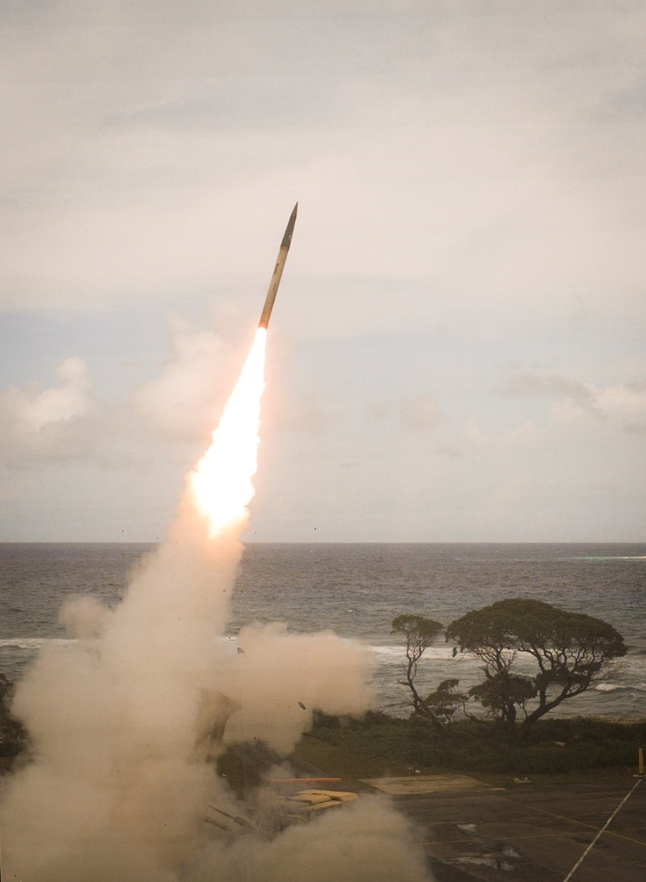
Further Flight Tests
5 October 2011
Successful endo-atmospheric intercept of two targets with two interceptors
24 October, 2012
Test of integration of THAAD with Patriot and Aegis against raid of 5 missiles of different types.
First time THAAD intercepted a Medium Range Ballistic Missile (MRBM)

Slide 23
Sources
www.mda.mil (Missile Defense Agency)
http://www.lockheedmartin.com/us/ssc.html (Lockheed Martin Space Systems)
http://www.vision.caltech.edu/~eeyjolfs/htmls/navigation.html (CalTech)
http://www.airdefenseartillery.com/
http://www.raytheon.com/
https://www.youtube.com/

Slide 24
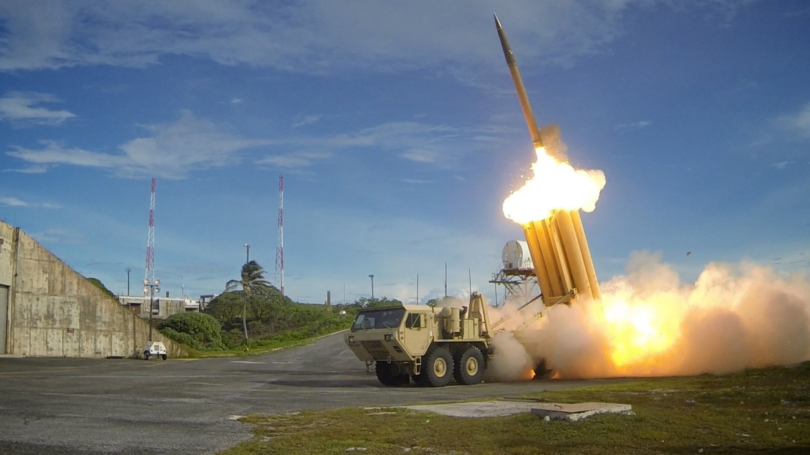
Questions?
Email: andrew.wrist@yahoo.com

