Slide 1
Aircraft oxygen systems
By: Phil Clay

Slide 2
Introduction
Background
Hypoxia Video
Oxygen Rules (FAR)
Non-OBOGS (On-board Oxygen Generating System) Oxygen Systems
OBOGS, and science behind it
Case study

Slide 3
Background
As altitude increases, percent of oxygen in the air decreases
Time of Useful Consciousness (TUC)
Altitude (thousands of feet) | Time of useful consciousness
15 | 30 minutes or more
18 | 20-30 minutes
22 | 5-10 minutes
25 | 2-3 minutes
28 | 2.5-3 minutes
30 | 1-3 minutes
35 | 30-60 seconds
40 | 15-20 seconds
45 | 9-15 seconds
50 | 6-9 seconds

Slide 4
Hypoxia example
https://www.youtube.com/watch?v=UN3W4d-5RPo
Dr. O’Neill’s addendum: https://youtu.be/OmeJlewaU7s
Training systems are critical aircraft systems
The training systems for the future T-X program is strongly stressed in the USAF requirements.
If you are a civilian pilot, you should find a local FAA training facility and do a hypoxia chamber test…

Slide 5
Oxygen Rules
FAR 91.211
Above 12,500’ for more than 30 mins
Above 14,000’
Above 15,000’
Pressurized above 25,000’
Pressurized above 35,000’

Slide 6
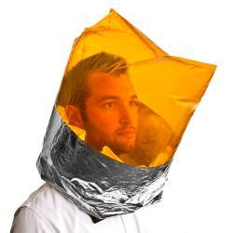
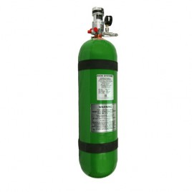
System types
5 different systems
Continuous Flow
Altitude Adjustable
Altitude Compensating
Demand
Pressure-Demand

Slide 7
Non-OBOgs oxygen systems

Slide 8
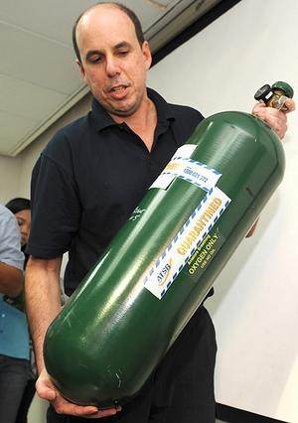
Non obogs oxygen systems drawbacks
Expensive
Potentially dangerous
Takes up a lot of space to store the oxygen
Time limited

Slide 9
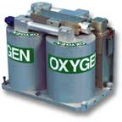
Obogs (on board oxygen generating system)
Positives
Compact
Unlimited
Very little maintenance
Lowest cost
Gas purity
Negatives
Without bleed air, cannot fuction
Can potentially drain battery

Slide 10
Science behind Obogs
High pressure air from turbine
3rd stage of compression in the T-6
Pressure swing absorbtion
Zeolites
High pressure vs. Low pressure

Slide 11
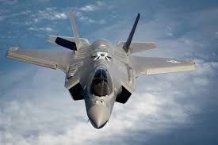
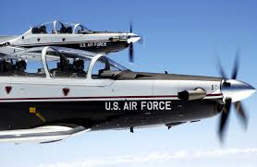
Aircraft with OBOGS
F-35
T-6
B-1
B-2
F-18
Many more…

Slide 12
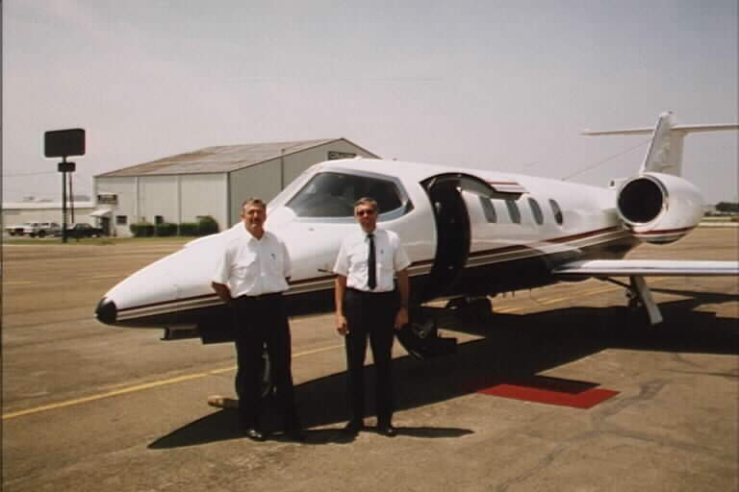
Case study
Payne Stewart Crash
October 25th ,1999

Slide 13
Case Study
ValuJet Flight 592

Slide 14
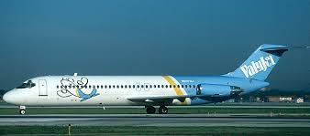
Background
Company founded in 1992
Known for cost cutting measures
Very little training provided to workers
Maintenance performed by contractors

Slide 15
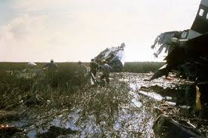
Flight 592
Scheduled from Miami, FL to Atlanta, GA on 11 May, 1996 (DC-9)
105 Passengers
5 crew
20 minutes after take-off, smoke begins to fill passenger cabin
31 minutes into the flight, the aircraft impacted the ground in the everglades killing all on board

Slide 16
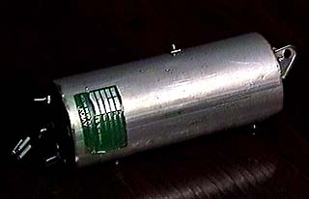
NTSB Findings
Chemical Oxygen generators in cargo hold caught fire
Shortly before Take-off, boxes of “empty” oxygen bottles loaded into cargo hold
Improperly boxed/packaged
Loud bang on CVR when smoke starts filling the cabin
NTSB report places responsibility for accident on three parties:
SabreTech
ValuJet
FAA

Slide 17
Summary
Background
Oxygen Rules (FAR)
Non-OBOGS Oxygen Systems
OBOGS, and the science behind it
Case study

Slide 18
Sources
Wikipedia
https://en.wikipedia.org/wiki/Time_of_useful_consciousness
AOPA Website
http://www.aopa.org/Pilot-Resources/PIC-archive/Pilot-and-Passenger-Physiology/Oxygen-Use-in-Aviation
Honeywell Life support systems pamphlet

Slide 19
Questions?
pmclay@crimson.ua.edu

