Slide 1
Engine Failure in Multiengine Aircraft
Mike Poremba
Aircraft Systems

Slide 2
Outline
Who I Am
VMC
What is VMC
Why is VMC important
VMC Correction
Engine Failure in Small Multiengine Aircraft
Piper Seminole Engine Systems
Engine Failure in Larger Multiengine Aircraft
Gulfstream G450
Boeing 737
Case Study 1: TransAsia Flight 235
Case Study 2: Delta Airlines Flight 295

Slide 3
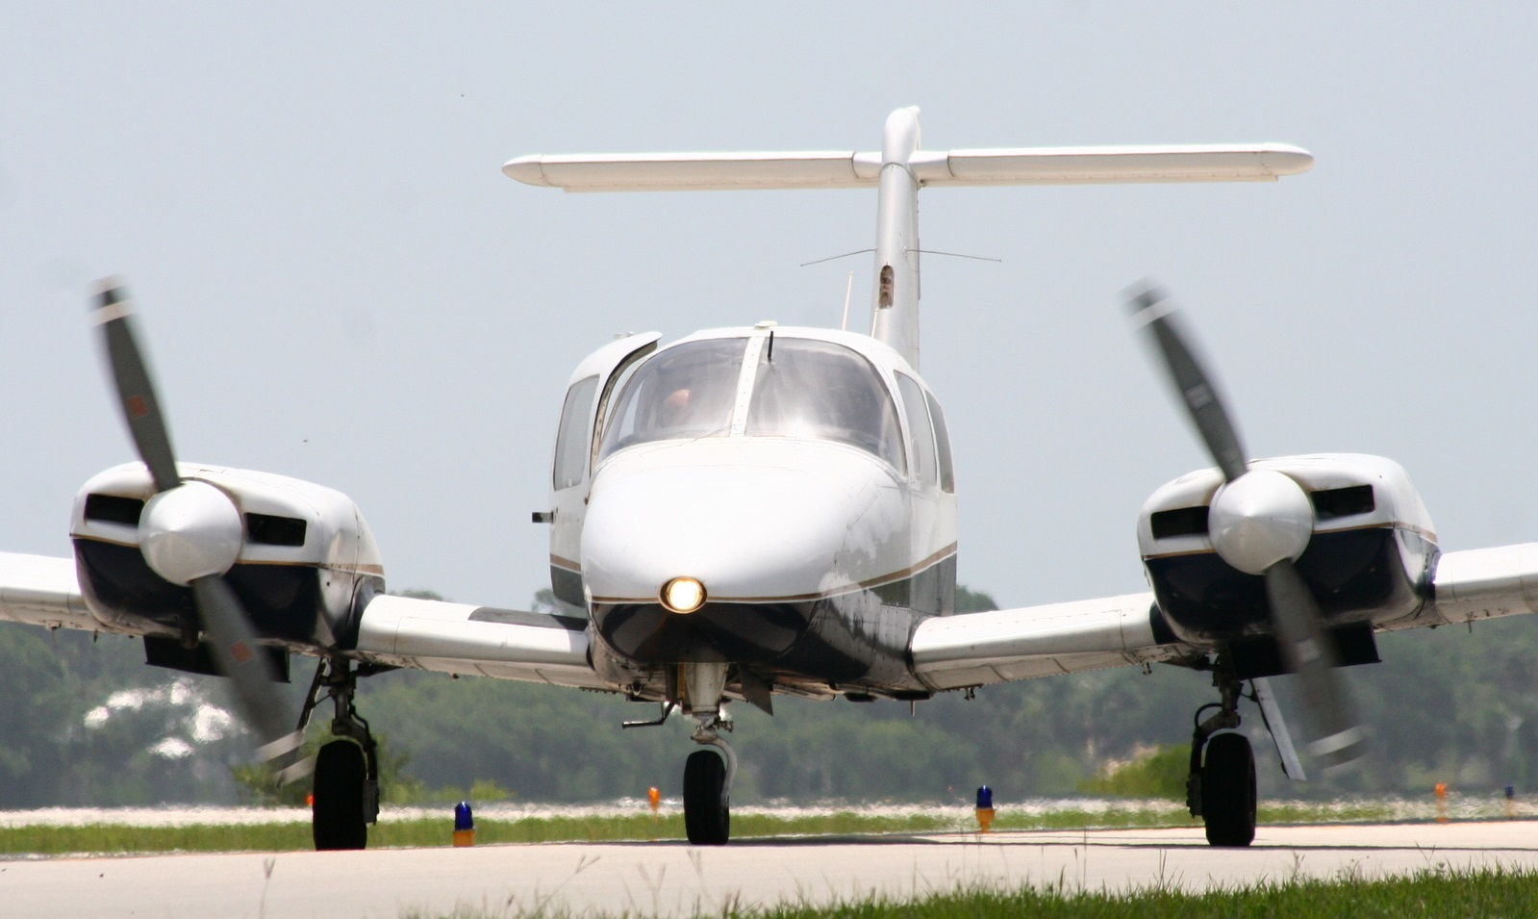
Who I am
Graduate Student
MS Aerospace Engineering
Pilot
Multi-Engine Commercial Rating
Flying Since 2005
Piper Seminole
Beechcraft Duchess

Slide 4
What is VMC
Defined Based on 14 CFR 23.149(a)
“VMC is the calibrated airspeed at which, when the critical engine is suddenly made inoperative, it is possible to maintain control of the airplane with that engine still inoperative, and thereafter maintain straight flight at the same speed with an angle of bank of not more than 5 degrees. The method used to simulate critical engine failure must represent the most critical mode of powerplant failure expected in service with respect to controllability.”

Slide 5
Why is VMC Important?
VMC is the airspeed which if above will allow the aircraft to maintain directional control.
https://www.youtube.com/watch?v=ZBcvb400JgM

Slide 6
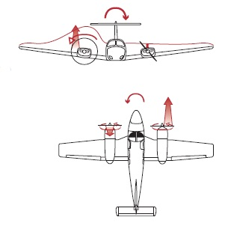
Effects on Aircraft During Engine Failure
Pitch Down
Due to the loss of induced airflow over the horizontal stabilizer
Roll towards dead engine
Due to loss of accelerated slipstream over the dead engine wing
Yaw towards dead engine
Due to the asymmetrical thrust situation
Climb performance decreased by 80%

Slide 7
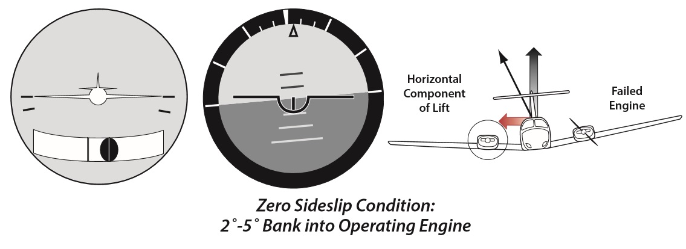
VMC Corrections
Bank 3-5 degrees into the good engine
Lift vector is directed opposite to the yaw induced by the engine
Reduces the amount of rudder required for directional control
Feather the propellers (If available)

Slide 8
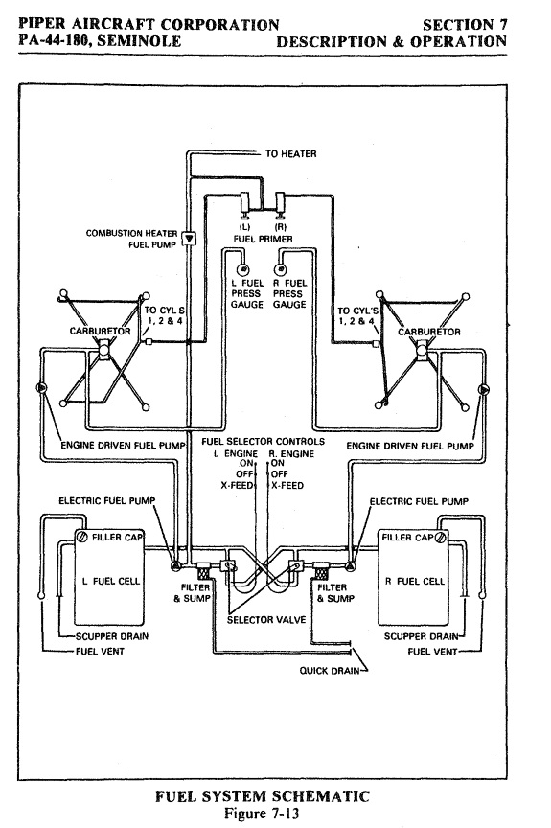
Piper Seminole Fuel System
Engine Nacelle Tanks
Two 55 Gallon Tanks
100LL
2 Engine Driven Pumps
2 Electrically Driven Pumps
Cross Feed System

Slide 9
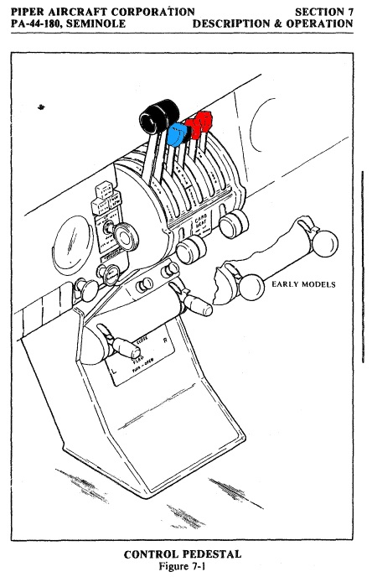
Piper Seminole Engine System
Lycoming
2 x 180HP
Piston Driven
Horizontally Opposed
Air Cooled
Normally Aspirated
Direct Drive
Propeller
Twin Blade Metal Propellers
Controllable Pitch
Constant Speed
Full Feathering

Slide 10
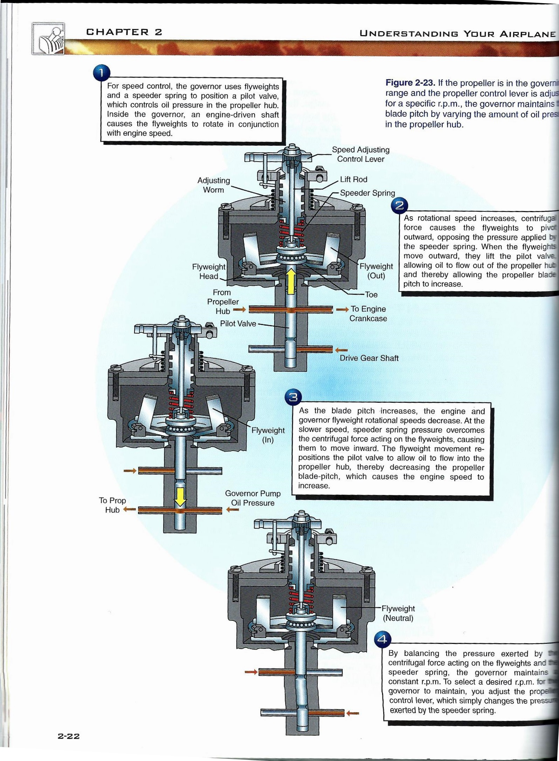
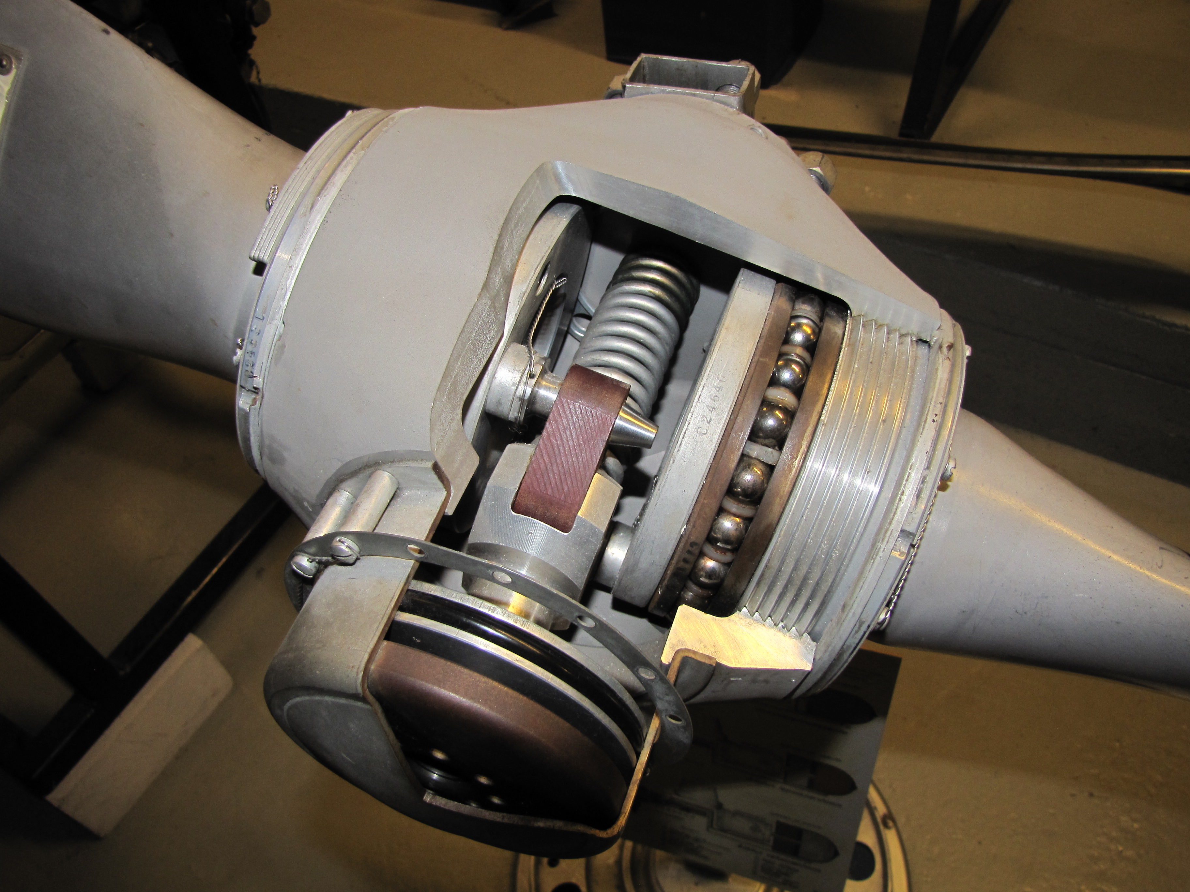
Piper Seminole Propeller System

Slide 11
Large Multiengine Aircraft Systems for Engine failure
Fuel System
Shut off Values
Fuel Dump
Pneumatic System
Hydraulic System
Fire System
Fire Extinguishers

Slide 12
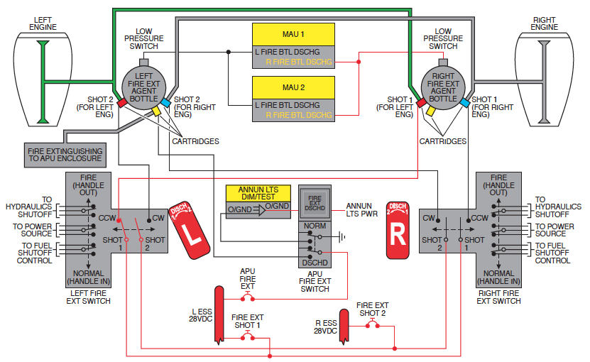
Gulfstream G450 Fire System
Sensors
7th and 12th stage in compressor
At Bleed Air
Inboard of the Engine
Left Engine at anti-ice duct
Fire Extinguishers
Two bottles located in the tail

Slide 13
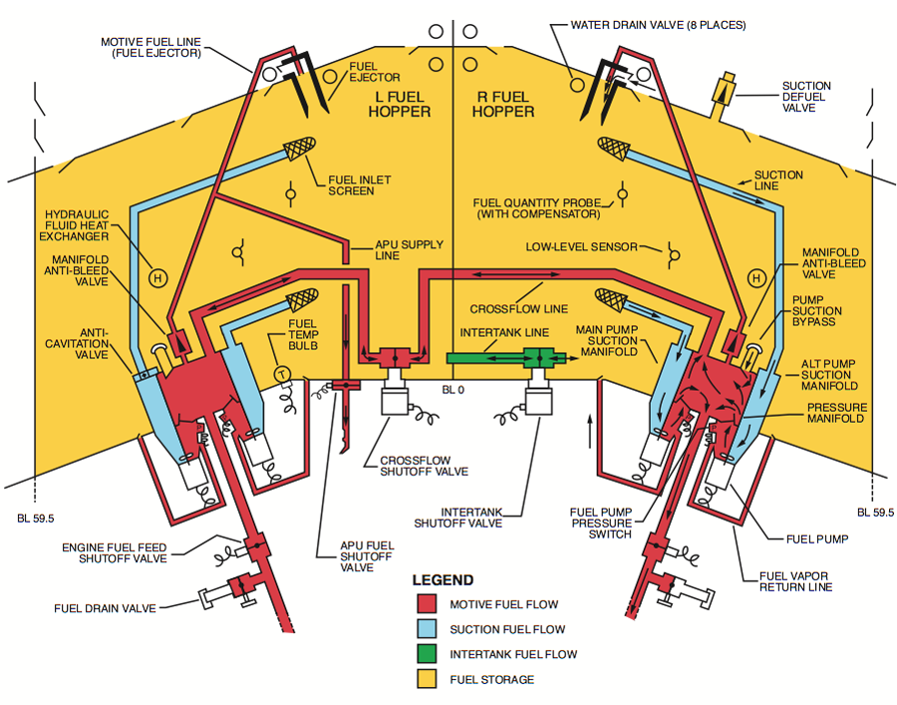
Gulfstream G450 Fuel System
Engines
Rolls-Royce Tay-611-8c
13,580 lbs thrust
Fuel
2 Wing Tanks
29,500 lbs.
Series of pumps and lines to supply fuel to the engine

Slide 14
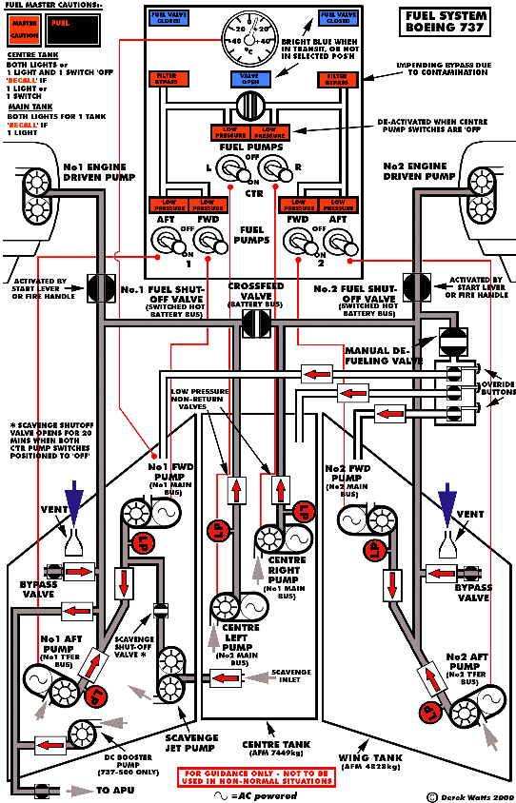
Boeing 737 Fuel System
Three Fuel Tanks
Two Wing tanks
One Center Tank
6800 Gallons of Jet A
Cross Feed System
Shut Off Valves
No Fuel Dump System

Slide 15
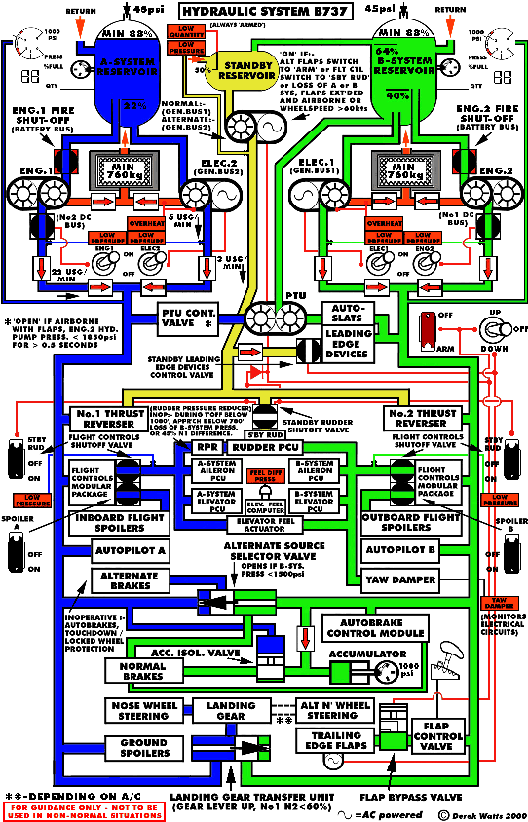
Boeing 737 hydraulic system
Two Hydraulic Systems
Both engines power both systems
Standby system
Both Systems Control
Autopilot
Rudder PCU
Elevator Actuators
Aileron PCU

Slide 16
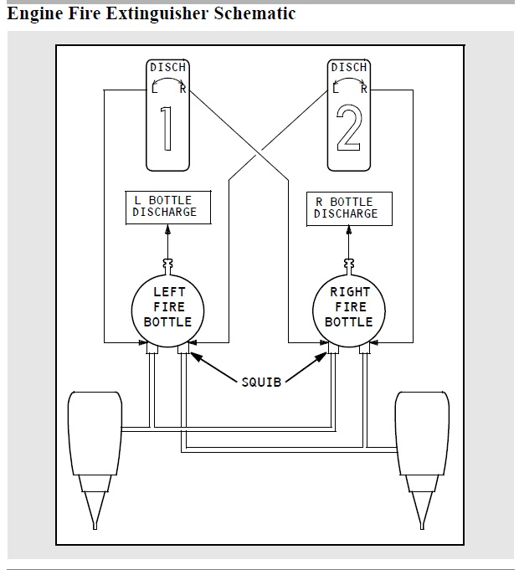
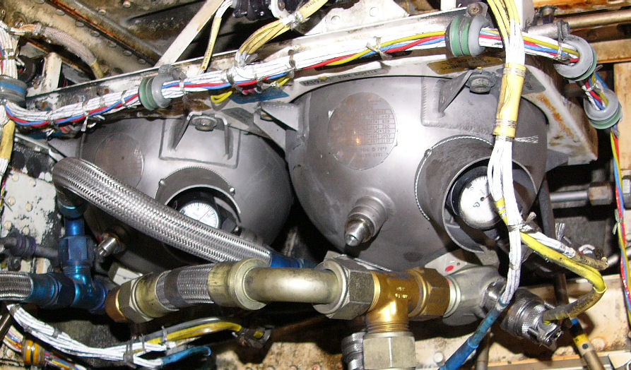
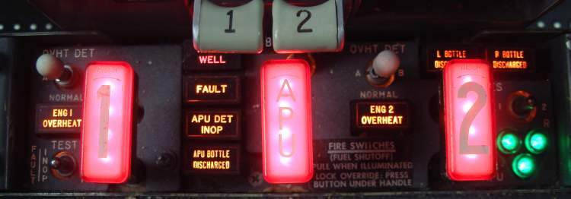
Boeing 737 fire system
Two Fire Bottle’s for Engines
One Bottle for APU

Slide 17
Boeing 747 Fire system operation
https://www.youtube.com/watch?v=ltMFvT6YxAM

Slide 18
Case Study 1: TransAsia Flight 235
February 6th 2015, 10:52am
Aircraft
ATR 72-600
List of Events
Two Minutes After Takeoff Right Engine Failure Alert
Pilots Reduce Power to Left Engine
Stall Warning sounds
Crew Cuts power to left engine
Crew realizes mistake and starts the left engine
Master Warning Sounds
Plane Clips a bridge and crashes into a river

Slide 19
Case Study 2: Delta Airlines Flight 295
September 21, 2014
Boeing 747
List of Events
Aircraft was taking off at Hartsfield's-Jackson Airport
At 400 ft. AGL the pilots heard a loud bang and the airplane yawed.
Noted that engine 4 instrument indicated a loss of power
Engine failure and shutdown completed for engine 4
AT 1300 ft. AGL engine 4 fire warning activated

Slide 20
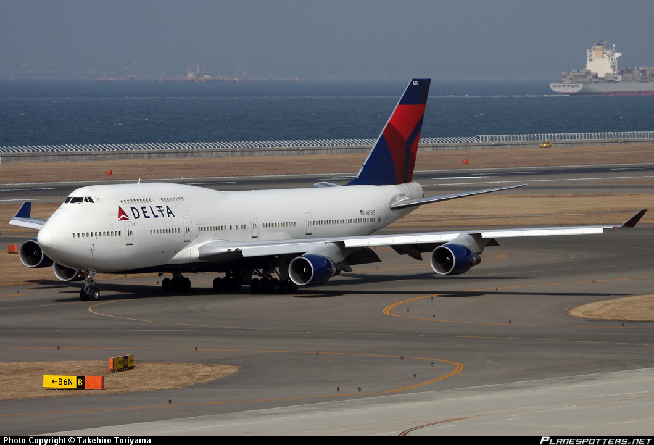
Case Study 2: Delta Airlines Flight 295
List of events continued
Pilots discharged A fire bottle into engine 4
Fire warning remained illuminated for 1 minute
Pilots discharged B fire bottle into engine 4
Warning extinguished after 20 seconds
Pilots dumped 280,000 lbs. and returned to airport

Slide 21
Boeing 747 Fuel Dump
https://www.youtube.com/watch?v=Hn2gvinGKMg

Slide 22
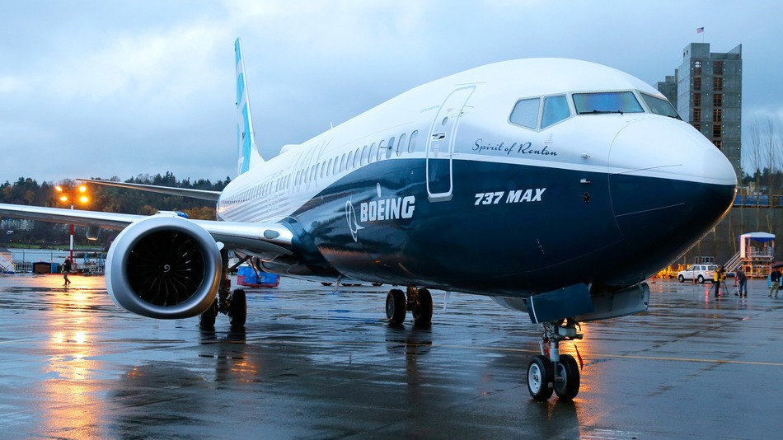
Questions?
Email: Mjporemba@Crimson.ua.edu

