Slide 1
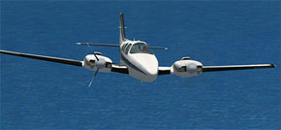
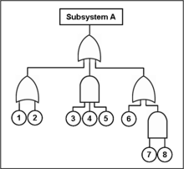

AEM 617: Aircraft Systems
System Redundancy in Aircraft Design
Steve Pomroy
MSAEM Candidate
University of Alabama
1/17

Slide 2
System Redundancy in Aircraft Design
Redundancy, Reliability, Safety
Multi-Engine Aircraft
Flight Data: Pitot-Static
Flight Controls
Electrical System
Fuel System
Hydraulic System
2/17

Slide 3
System Redundancy in Aircraft Design
Redundancy, Reliability, Safety
Redundancy:
the inclusion of extra components that are not strictly necessary to functioning, in case of failure in other components.
(google.com)
- Single Redundancy
- Triple Redundancy
Reliability:
An attribute of any system that consistently produces the same results, preferably meeting or exceeding its specifications.
(dictionary.com)
- Probability of Failure
- Mean Time Between Failure
- Dispatch Rate
Safety:
- freedom from harm or danger: the state of being safe
- the state of not being dangerous or harmful
(merriam-webster.com)
- Probability of Harm
- Rate of Harm
3/17

Slide 4
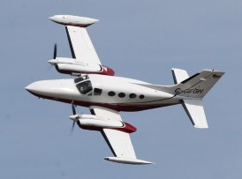
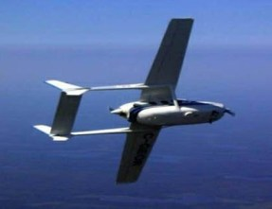
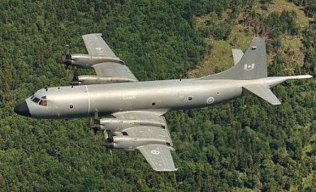
System Redundancy in Aircraft Design
Multi-Engine Aircraft
Tolerant of multiple
engine failures.
Engines are sometimes
“loitered”on station.
4/17

Slide 5
System Redundancy in Aircraft Design
Multi-Engine Aircraft – Performance
5/17

Slide 6
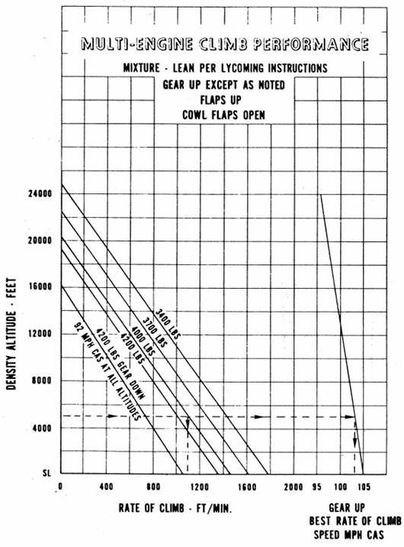
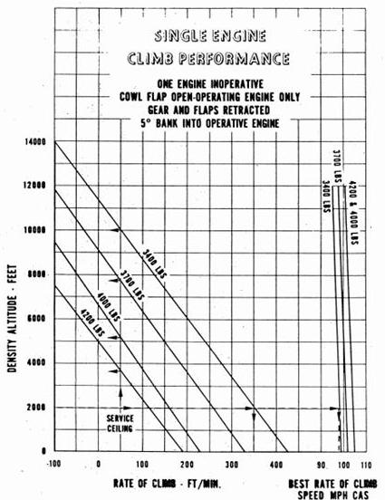
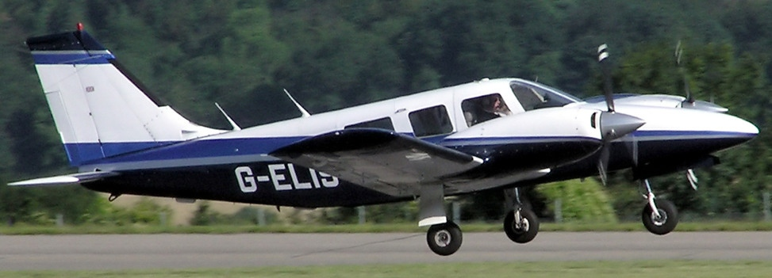
System Redundancy in Aircraft Design
Multi-Engine Aircraft – Performance Example (PA-34)
Piper PA-34
(Seneca)
480
800
-75
40
6/17

Slide 7
System Redundancy in Aircraft Design
Multi-Engine Aircraft – Certification
Not all normal category ME aircraft need to be able to climb (or even maintain altitude) after a failure.
FAR 23.67 Climb: One-Engine Inoperative
(a) For normal, utility, and aerobatic category reciprocating engine-powered aeroplanes of 6,000 pounds or less maximum weight, the following apply:
(1) Except for those aeroplanes that meet the requirements prescribed in 23.562(d), each aeroplane with a VSO of more than 61 knots must be able to maintain a steady climb gradient of at least 1.5 percent at a pressure altitude of 5,000 feet with the:
(i) – (v) 5 operating conditions here
(2) For each aeroplane that meets the requirements prescribed in 523.562(d), or that has a VS0 of 61 knots or less, the steady gradient of climb or descent at a pressure altitude of 5,000 feet must be determined with the:
(i) – (v) 5 operating conditions here
7/17

Slide 8
System Redundancy in Aircraft Design
Multi-Engine Aircraft – More Certification
FAR 23.67
(c) For Commuter Category Airplanes
Positive climb gradients required under
all conditions at takeoff altitudes,
but not necessarily at cruise altitudes.
FAR 25.121
Climb – One Engine Inoperative
FAR 23.123
En-Route Flight Paths
8/17

Slide 9
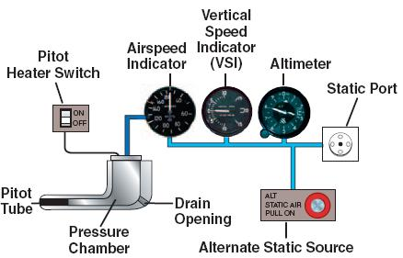
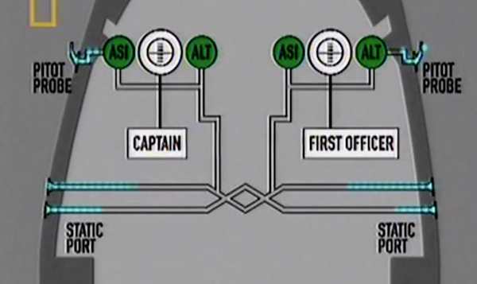
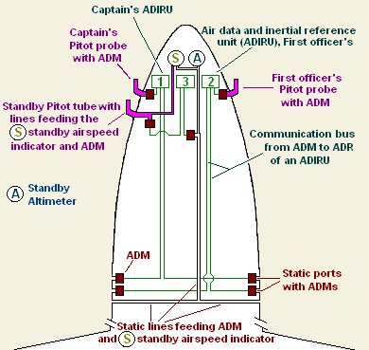
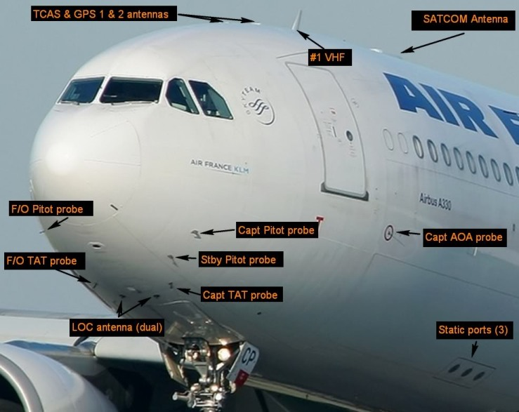
System Redundancy in Aircraft Design
Flight Data: The Pitot Static System
Pitot Heat and Alternate Static Requirements:
- CFR 14 FAR 23: 1323, 1325, 1326
- CFR 14 FAR 25: 1323, 1325, 1326
– Air France 447
9/17

Slide 10
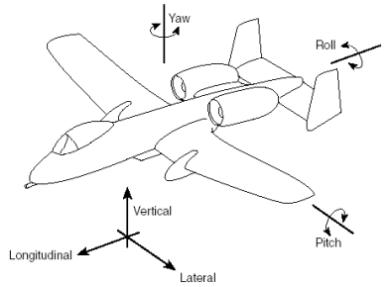
System Redundancy in Aircraft Design
Flight Controls – Aerodynamic/Inherent Redundancy
LOSS: Usually Non-Critical.
Can use differential power.
YAW: Z-Axis. Rudder.
ROLL: X-Axis. Aileron.
LOSS: Secondary effect of yaw – Rudder.
PITCH: Y-Axis. Elevator.
LOSS: Trim, Power.
10/17

Slide 11
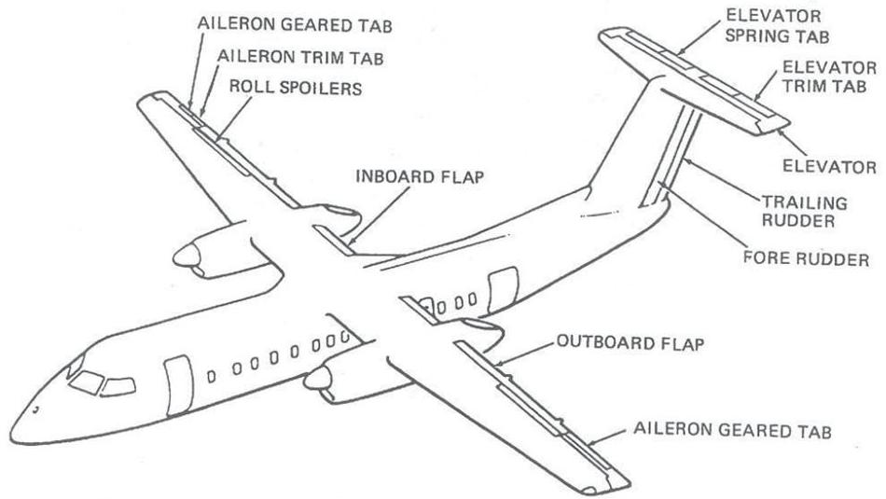
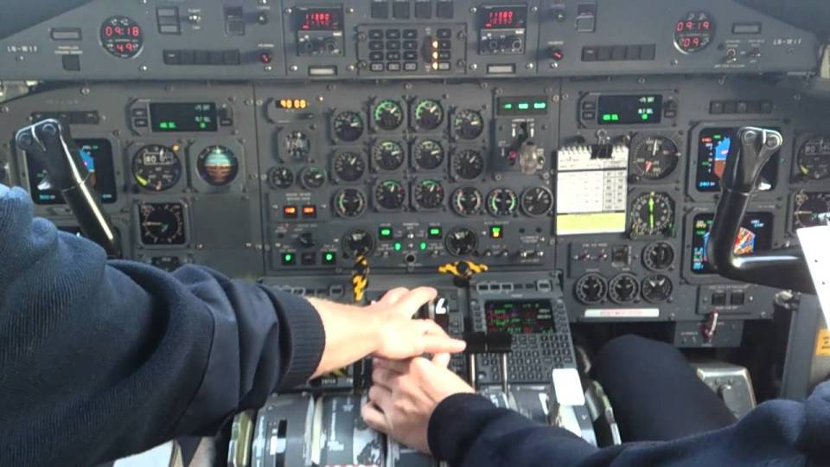

System Redundancy in Aircraft Design
Flight Controls – Designed/Artificial Redundancy
de Havilland DHC-8
11/17

Slide 12
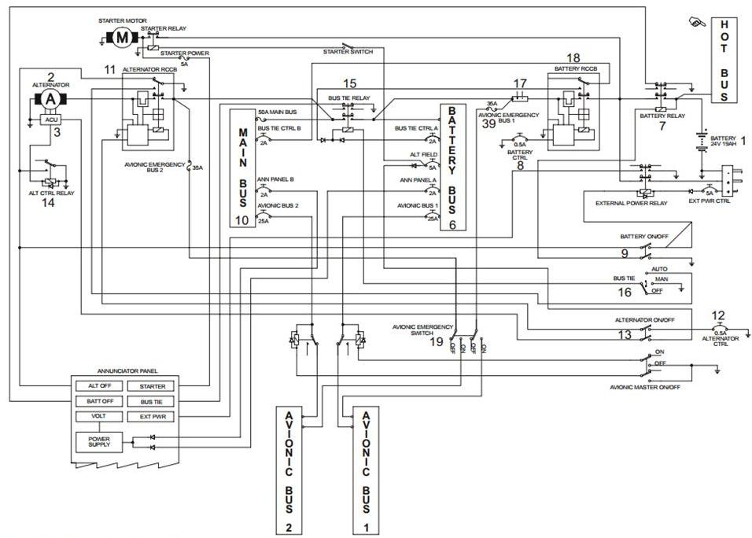
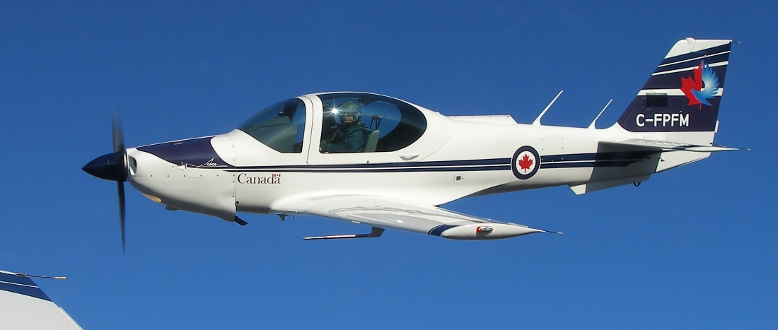
System Redundancy in Aircraft Design
The Electrical System
Grob G-120A
Usually 1 alternator
per engine.
12/17

Slide 13
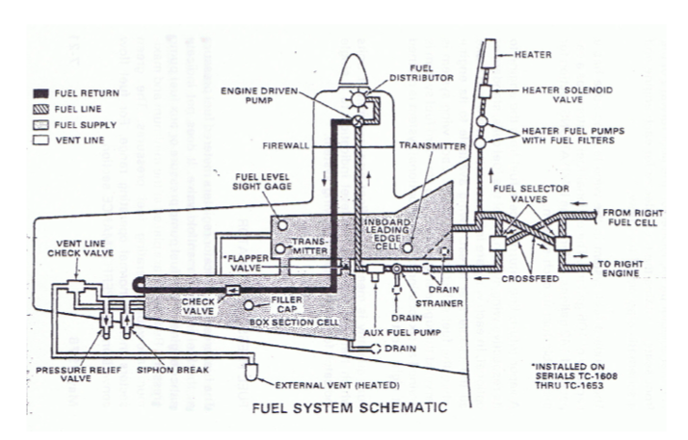
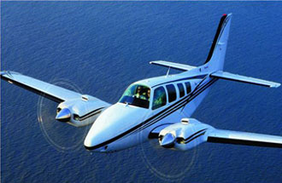
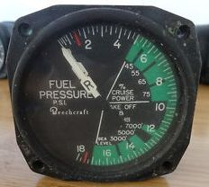
System Redundancy in Aircraft Design
The Fuel System
Beech B55 (Baron)
Fuel System Independence:
- CFR 14 FAR 23: 953
- CFR 14 FAR 25: 953
13/17

Slide 14
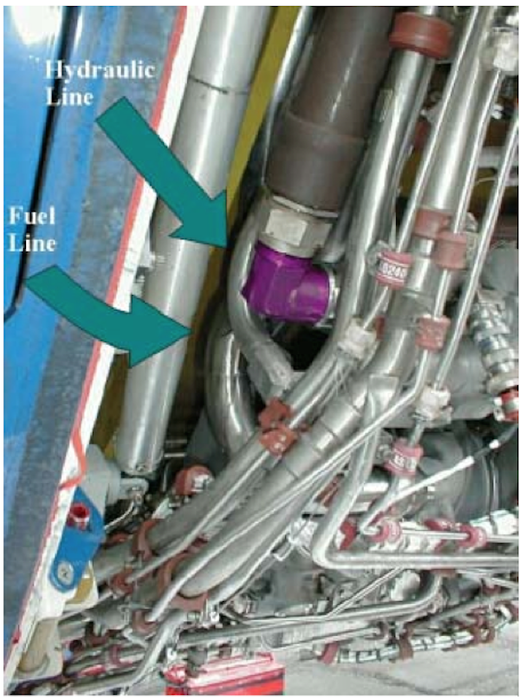
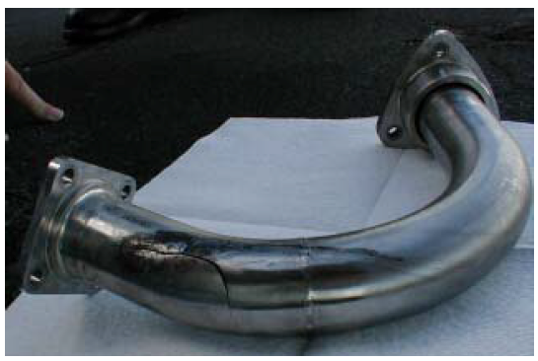
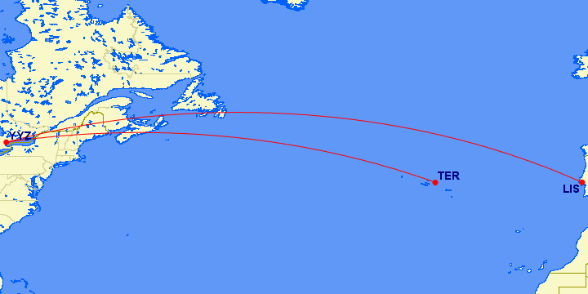
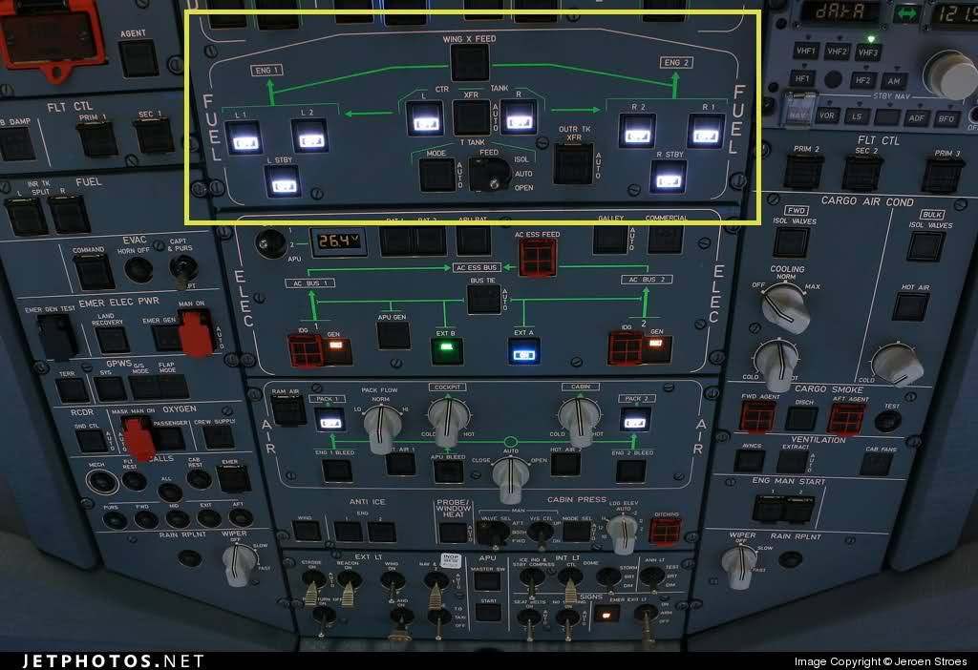

System Redundancy in Aircraft Design
The Fuel System – Case: Air Transat 236
Airbus A330:
Air Transat 236
14/17

Slide 15
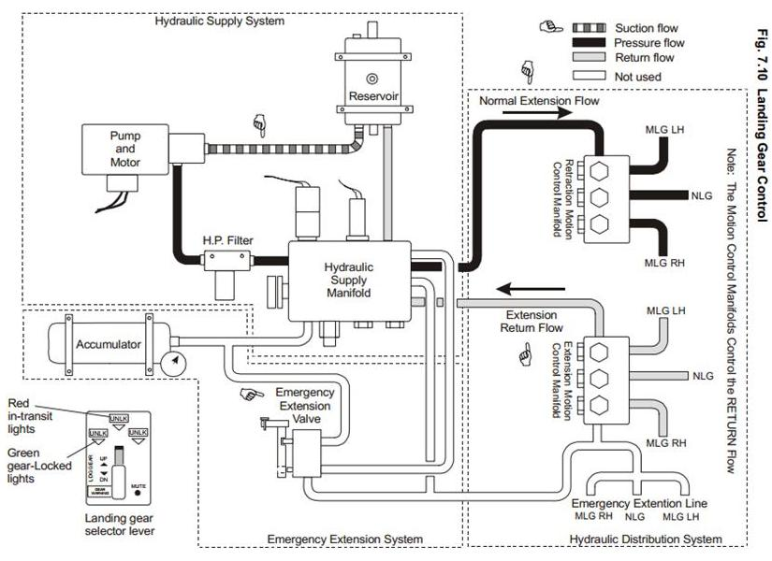
System Redundancy in Aircraft Design
The Hydraulic System
Grob G-120A
15/17

Slide 16
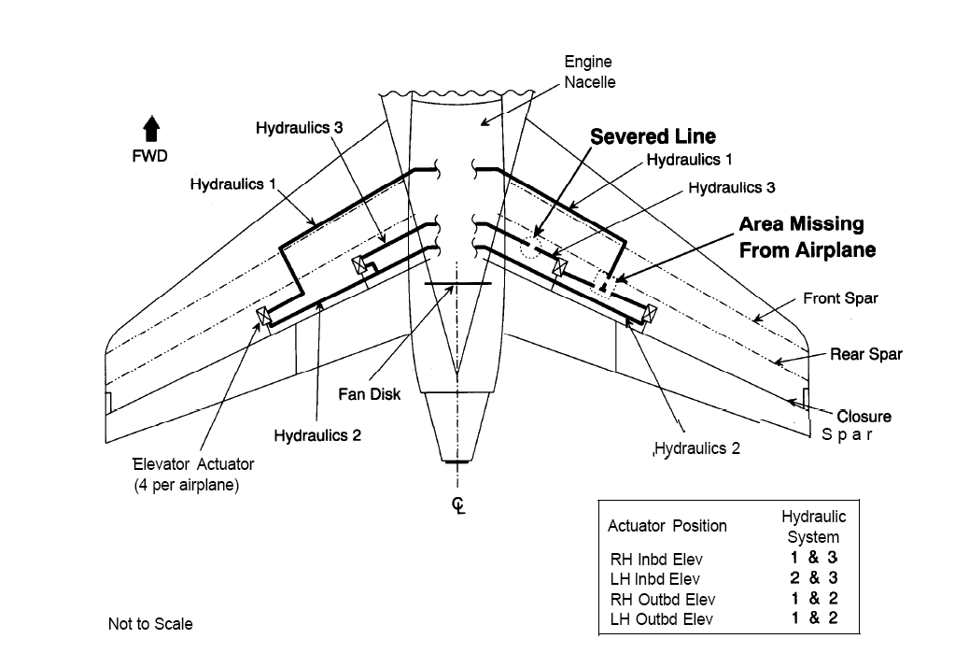
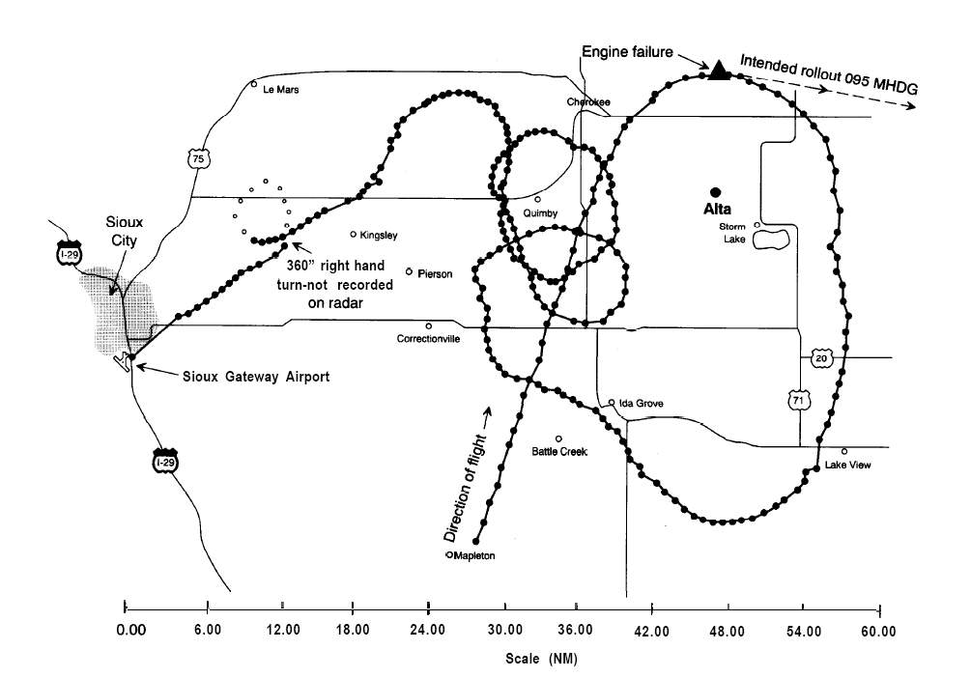

System Redundancy in Aircraft Design
The Hydraulic System – Case: United Airlines 232
DC-10:
United Airlines 232
FAILED REDUNDANCY:
– Calculated Probability: 1x10⁻⁹.
– Based on independent failures.
AERODYNAMIC REDUNDANCY:
– Differential Thrust.
– 185 Survivors out of 296.
16/17

Slide 17
System Redundancy in Aircraft Design
Some Recommended Reading:
- https://en.wikipedia.org/wiki/Redundancy_(engineering)
- https://en.wikipedia.org/wiki/Fault_tolerance
- Reason, J. Managing the Risks of Organizational Accidents. Ashgate Publishing
Note on copyright of images:
– None of the images in this presentation belong to the author.
– While some of the images used in this presentation are in the public domain, others are
subject to copyright, and are being used here under the Fair Use (USA) or Fair Dealing
(Canada) doctrine.
17/17

