Slide 1
AEM 617 Lecture
Investigation of the Swissair 111 Disaster
feat. Aircraft Wiring
Carson Haack
The University of Alabama

Slide 2
Case Study: Swissair Flight 111
Halifax Terminal ATC: Swissair one eleven just a couple of miles I'll be right with you.
Swissair 111: Roger. [sound of autopilot being disconnected] And we are declaring emergency now, Swissair one eleven.
Halifax Terminal ATC: Copy that. Swissair one eleven you are cleared to, ah, commence your fuel dump on that track and advise me, ah, when the dump is complete.
Swissair 111: [unintelligible]
— Captain Urs Zimmermann and pilot Stephan Loew, Swissair 111, last recorded words before crashing off the coast of Nova Scotia, 2 September 1998.
2 September 1998, 0131 hours
McDonnell Douglas MD-11 crashed off the coast of Nova Scotia during flight between New York, NY and Geneva, Switzerland
Onboard fire led to failure of electrical systems and loss of aircraft control
All 229 people aboard killed

Slide 3
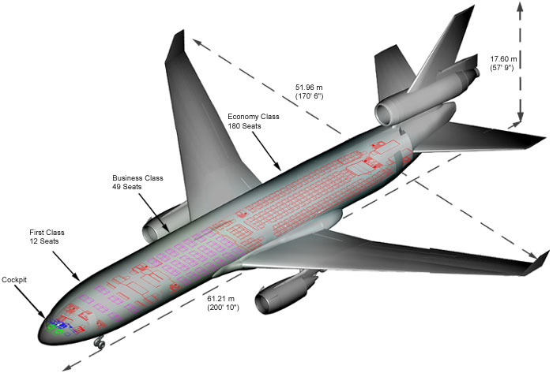
The Aircraft: McDonnell-Douglas MD-11
Entered service in 1990 as a replacement for the DC-10
Featured a “glass cockpit”, replacing mechanical gauges and displays with digital ones
Implemented lengthened fuselage, winglets, composites, different airfoil design
Introduced hydraulic fuses to prevent complete hydraulic pressure loss in the event of power loss to hydraulic system (see: American Airlines flight 191)
Production ceased in 2000, with 127 aircraft currently in service as freighters

Slide 4
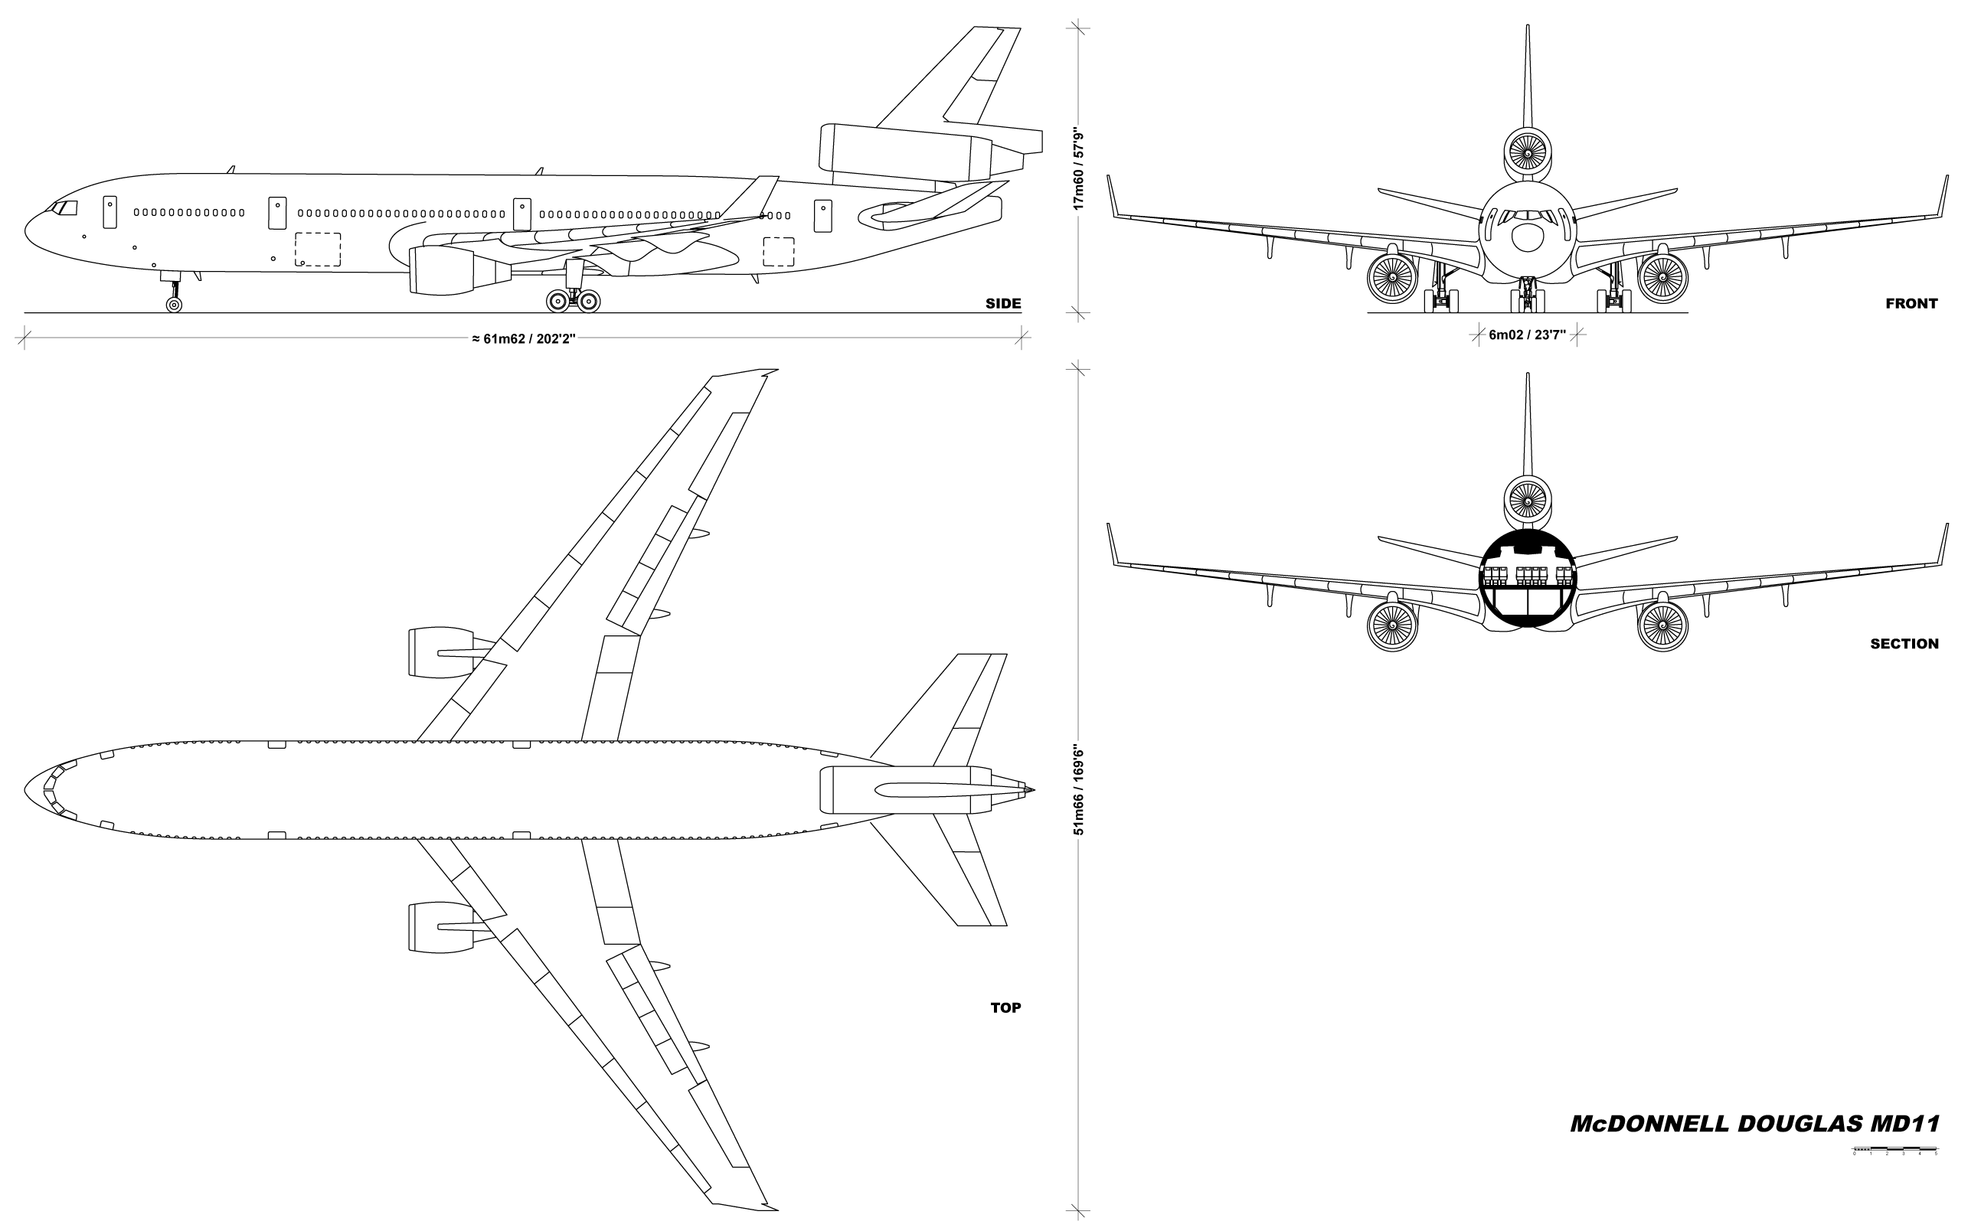

Slide 5
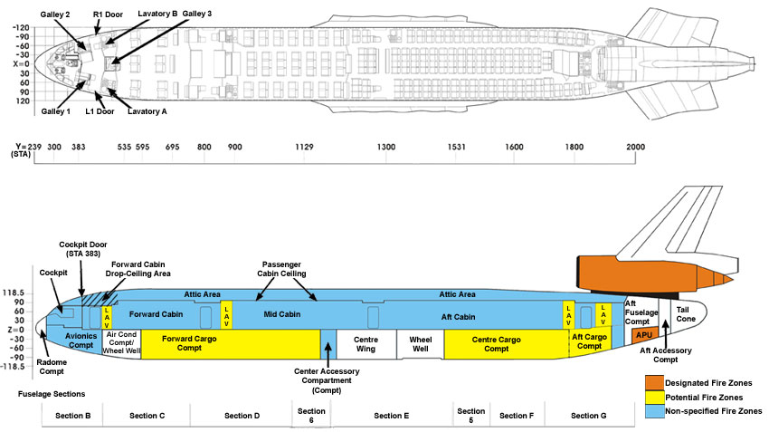

Slide 6
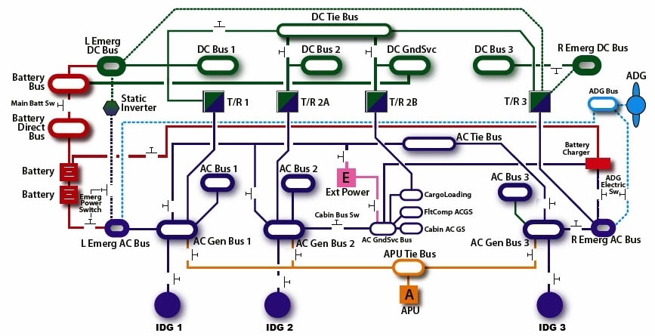
The Aircraft: Electrical System Overview
Electrical diagram of McDonnell Douglass MD-11

Slide 7
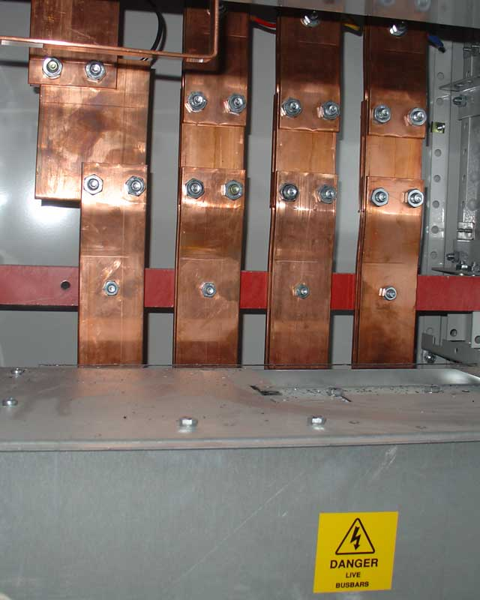
The Aircraft: Electrical System Overview
Glossary
AC – Alternating current
ADG – Air-driven generator: deployable turbine used to provide
emergency AC power
Bus – Metal bar that transfers electricity to other systems or within a switchboard
Ext Power – External power
IDG – Integrated-drive generator: provides electrical power from spinning engines
Static Inverter – Converts DC power to AC power with no moving parts
T/R – Transformer/Rectifier: converts AC power to DC power
Bus bar

Slide 8
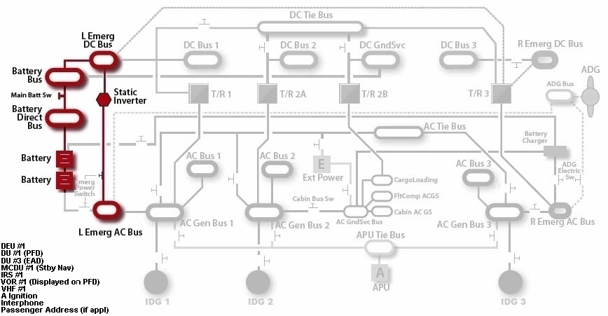
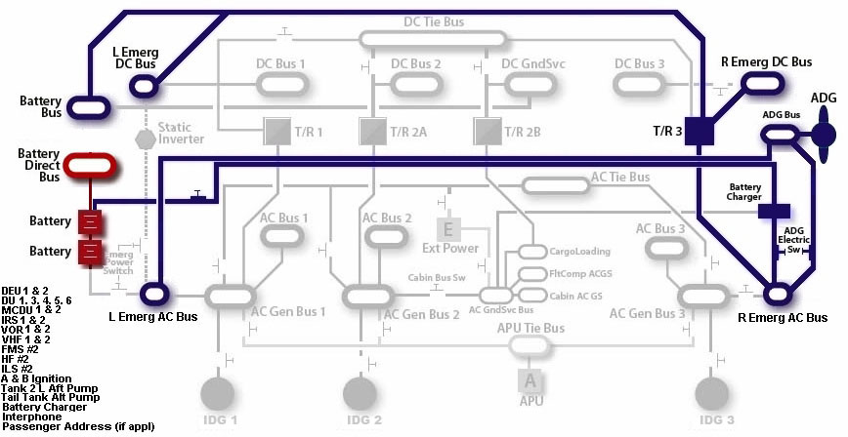
The Aircraft: Electrical System Overview
Emergency Power Mode: Battery Only
DEU – Display Electronic Unit
DU – Display Unit
EAD – Engine and Alert Display
MCDU – Multifunction Control Display Unit
IRS – Inertial Reference System (also called IRU) (for inertial navigation)
VOR – Very-high Frequency Omni-directional Range Beacon (for radio navigation)
PFD – Primary Flight Display
VHF – Very-high Frequency
ADG Power: Electric Mode
FMS – Flight Management System
HF – High Frequency
ILS – Instrument Landing System

Slide 9
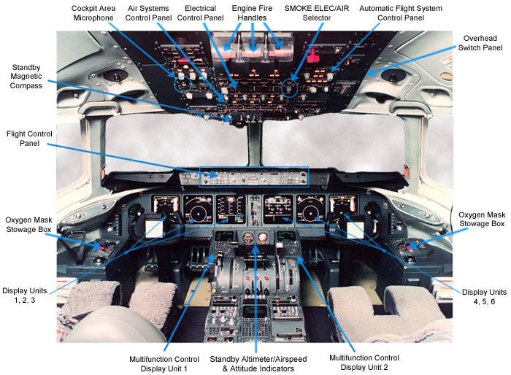
The Aircraft: Cockpit Layout

Slide 10
Outline of Events
Side note: Fuel Dumping
Some aircraft are equipped with systems to jettison fuel in case of emergency.
Just as aircraft have a max takeoff weight, they also have a max landing weight
Landing overweight may cause overloading of the aircraft structure, possibly leading to failure
Aircraft are required to have a fuel dump system if the ratio between max takeoff and max landing weight is greater than 1.05
0018 – SR 111 departs JFK airport
0110 – Pilots detect “unusual odor” in cockpit
0114 – Request to divert to Boston for emergency landing due to smoke in the cockpit. ATS advises an emergency landing in Halifax, Nova Scotia
0120 – Crew discusses possibility of performing a fuel dump, agrees to dump
0121 – ATS requests gross weight of aircraft (230 tonnes) and provides route to fuel dump location off coast
0123 – SR 111 notifies ATS of taking manual control and requesting clearance for lower altitude
0124 – Emergency declared, request for immediate fuel dump and landing
0125 – Second declaration of emergency, last transmission
0131 – Impact

Slide 11
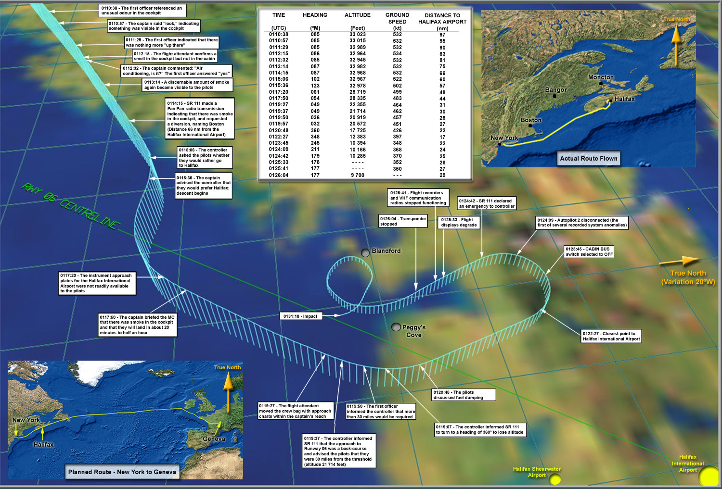

Slide 12
Swissair Flight 111 Voice Records (Part 1)
0:00-1:40 – Conversation between controllers and unknown party questioning whereabouts of the flight, possibly misplaced piece of audio.
1:50 – SR 111 mentions smoke in the cockpit and requests reroute to Boston
2:36 – ATS suggests reroute to Halifax, SR 111 gives a standby
3:11 – SR 111 confirms reroute to Halifax
3:36 – SR 111 broadcasts putting on oxygen mask
4:24 – ATS asks SR 111 for number of passengers and amount of fuel, long silence
5:50 – SR 111 directed to contact on radio frequency 119.2 MHz
6:43 – SR 111 given a radar vector for runway 6 at Halifax
(Part 2)
0:47 – SR 111 requests a fuel dump in the area
1:18 – ATS gives instructions to navigate to fuel dump area off of the coast
1:50 – Internal conversation between captain and crew in foreign language
3:41 – SR 111 informs ATS that manual control is being used, requests altitude block
3:57 – SR 111: “We are declaring emergency now”
4:54 – “Swissair 111, check you’re cleared for fuel dump”
5:00 – Transmission ends with unintelligible remark

Slide 13
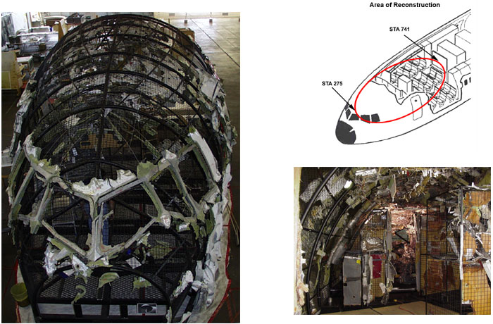
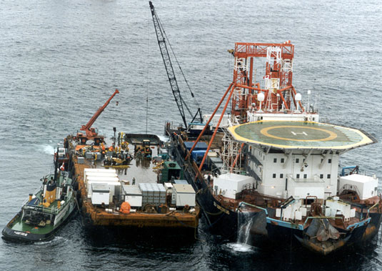
Investigation: Recovering the Aircraft
Crane and barge used to lift aircraft parts out of water
Reconstructed mockup of cockpit area of interest

Slide 14
Investigation: Recovering the Aircraft
Heavy lift Operations – Large crane used to lift pieces vertically out of the water. Useful for pieces that would be too large or heavy for a diver or skimmer. (150,000 lb recovered)
Scallop Drag Operations – A “rake” is dragged along the seabed behind a vessel, collecting materials too small to be worth using heavy lift, and too deep for divers. Good for collecting many smaller pieces. 1,839 runs were made. (75,000 lb recovered)
Remote Operated Vehicle Operations – Collect reconnaissance using sonar and laser scanning to provide possible wreckage locations and seabed topography
Suction Hopper Dredge Operations – A dredge is used to suck up portions of the seabed inaccessible to the other methods, then sift away sediment, leaving aircraft parts (28,000 lb recovered)
“Particular emphasis was placed on debris exhibiting heat damage, burn residue, or unusual markings.”

Slide 15
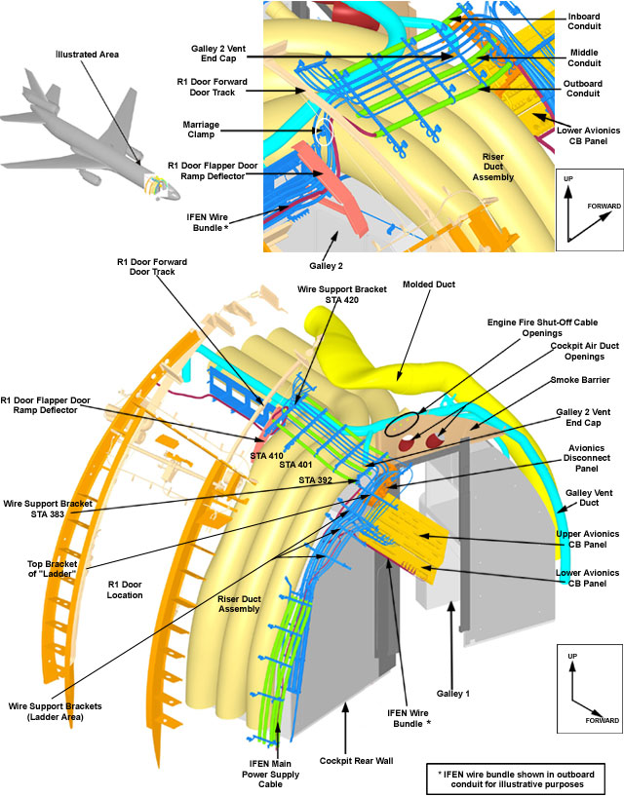
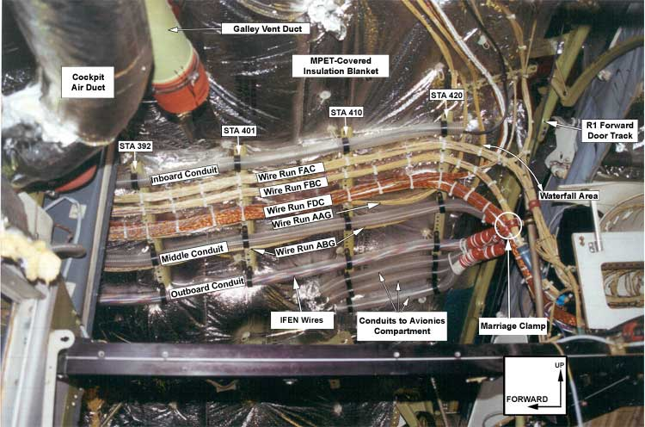
Investigation: Areas of Interest
Primary interest lies in areas exhibiting signs of fire damage, per the recording
Mostly in the cockpit and drop-ceiling area
Engines also an area of interest – evidence of cutoff

Slide 16
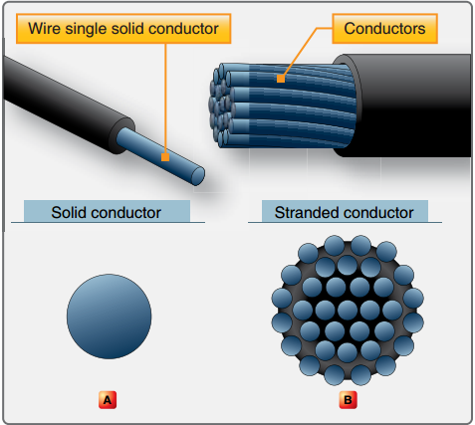
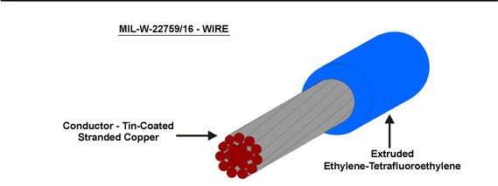
Aircraft Wires
Wire – A single solid conductor, or a stranded conductor, covered in an insulating material
- FAA Regulations and Policies Manual
Old standard: MIL-W-5086 A
600V
150 °C
Tin-coated copper
PVC insulation
New standard: MIL-W-22579
600V
150 °C
Tin-coated copper
Ethylene Tetrafluoroethelyne

Slide 17
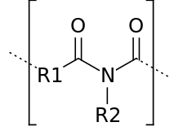
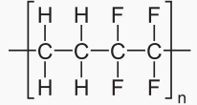
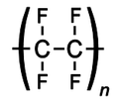
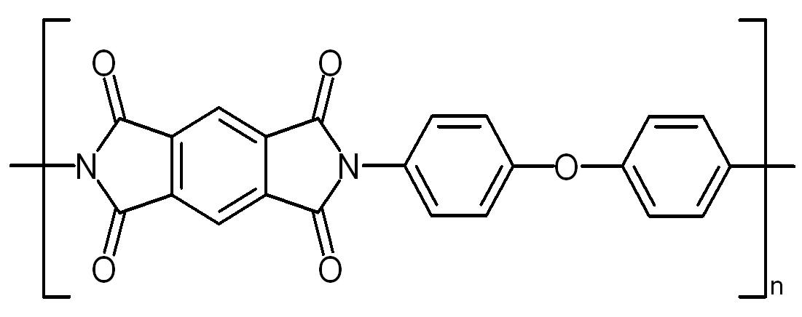
Aircraft Wires
Al or Cu conductor?
Copper – Higher conductivity, tensile strength, more ductile
Aluminum – Less expensive, lighter, less discharge at high potential
Plating
Metal plating of wires prevents oxidation, which hurts conductivity
Tin – Most common, easy to solder
Silver – Expensive, higher temperature capacity (200 °C)
Nickel – Highest temperature capacity (260 °C)
Insulation
Two biggest concerns: resistance, dielectric strength
Other factors: resistance to physical harm, thermal capacity, flame resistance, etc.
Current insulators: ETFE, PTFE/Kapton/PTFE, PTFE/Polyimide/PTFE
ETFE
PTFE-Teflon
Kapton
Polyimide Structure

Slide 18
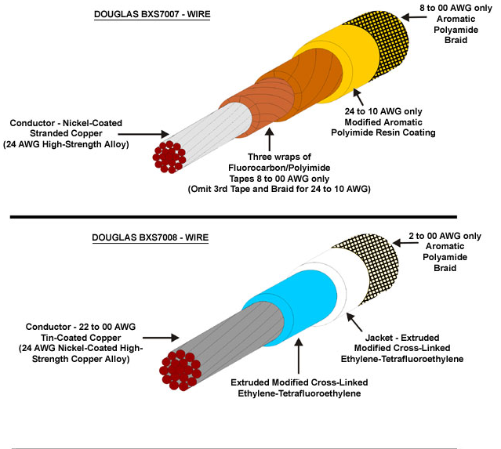
Aircraft Wires: The MD-11
Main difference is the insulation
7007 used in passenger compartments, and where temperatures could exceed 150 °C
7008 used as general purpose wire, cheaper
Most of the wire in the fire area was 7007
Side note: AWG (American Wire Gauge)
Represents diameter of wire using whole numbers
Wire runs represented by three letters
Location of run
Inside a conduit? RF interference category
Sequential order of local run
Ex. FDC is a wire that runs in the cockpit drop-ceiling, outside a conduit, third in the group
Other wires used on the MD-11

Slide 19
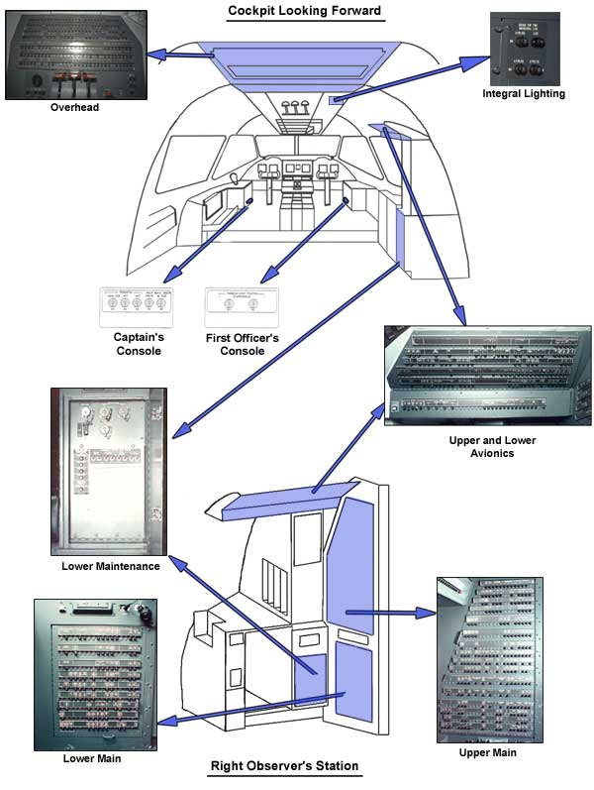
Circuit Breakers (Breaker Panel, Distribution Board)
CBs distribute a power feed amongst its attached circuits, and act as a protection against power surges.
Overhead panel draws power from:
DC Battery Bus, DC Battery Direct Bus
Left and Right Emergency Buses
Upper Avionics panel draws from:
AC Bus 1 and 3
DC Bus 1 and 3
AC Instrument Buses
Lower Avionics panel draws from:
DC Bus 2
DC Ground Bus
9 total CB panels, but only above 3 showed significant heat damage

Slide 20
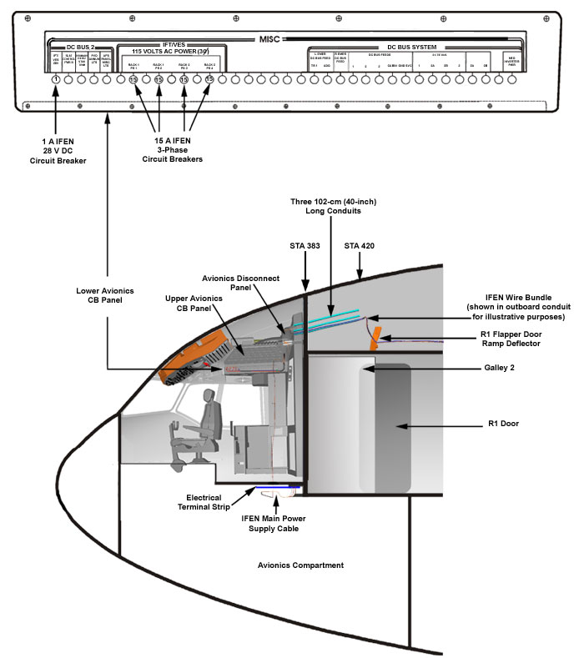
Circuit Breakers (Breaker Panel, Distribution Board)
Above: A single breaker
Right: Diagram of the lower avionics CB and its placement. The IFEN breakers are marked

Slide 21
Investigation: The IFEN
“The IFEN system combined computer, video, and audio technologies to allow passengers to select movies, audio, games, news, gambling, and the moving map display through an interactive seat video display.”
Four PSUs connected to 15 A CBs on the Lower Avionics Panel
PSUs convert 115 V AC power from the aircraft to usable 48 V power for IFEN
AC Bus 2 provides the 115 V power
1 A CB on Lower Avionics provided 28 V power to the IFEN relay assembly
Received power from slat control
Controls output from PSUs through relay
Used 22579 spec wire
Deemed “non-essential” equipment, to be isolated when the CABIN BUS switch is off
AC Bus 2 is not deactivated when CABIN BUS is off. Uh-oh…

Slide 22
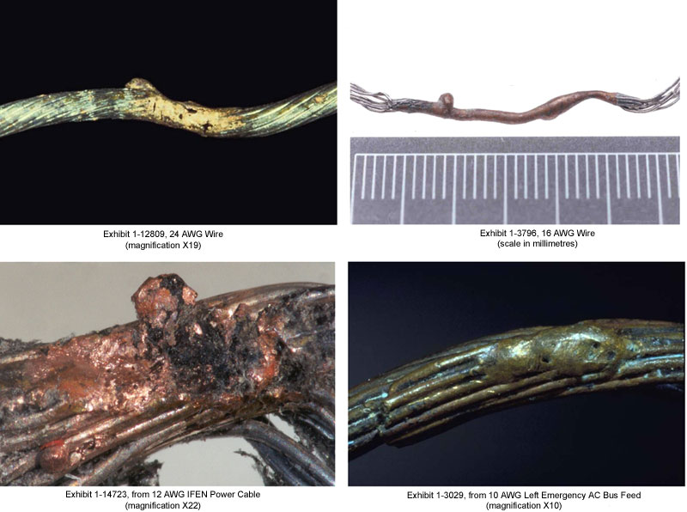
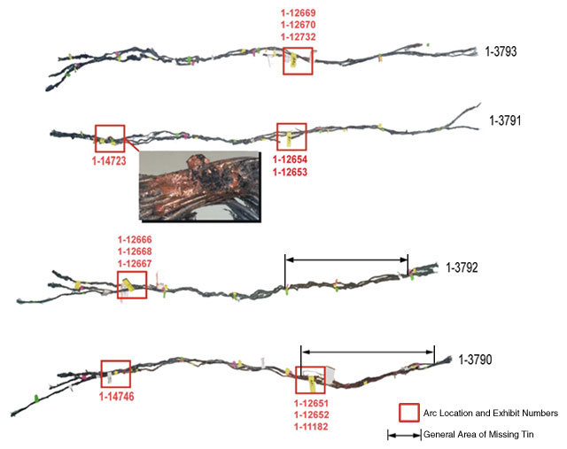
Investigation: The IFEN
“A segment of in-flight entertainment network (IFEN) power supply unit cable (1-3791) exhibited a region of resolidified copper on one wire that was caused by an arcing event. This resolidified copper was determined to be located near manufacturing station 383, in the area where the fire most likely originated. This arc was likely associated with the fire initiation event; however, it could not be determined whether this arced wire was the lead event.”

Slide 23
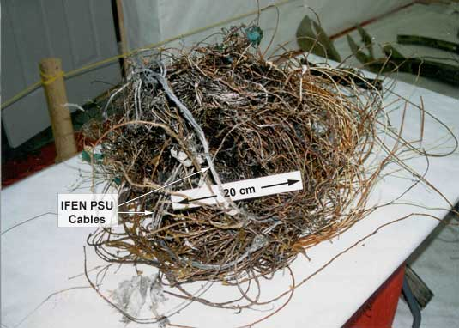
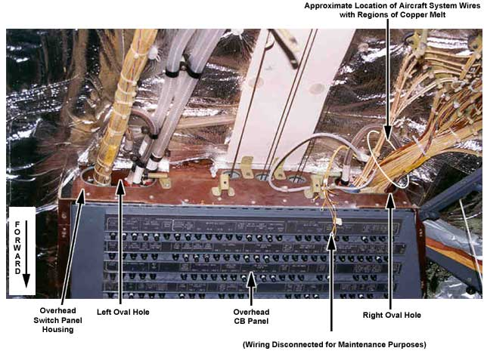
Investigation: The IFEN
Wires in above exhibit identified from remaining ETFE insulation on wire. Eight of the nine wire segments that showed signs from arcing were from IFEN.

Slide 24
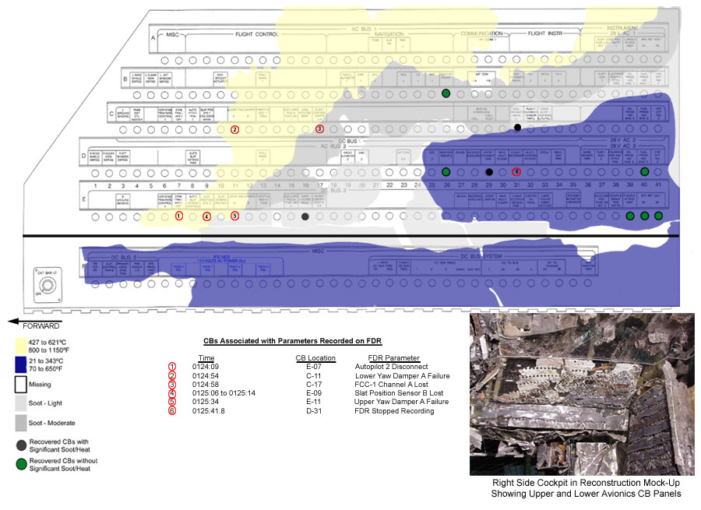
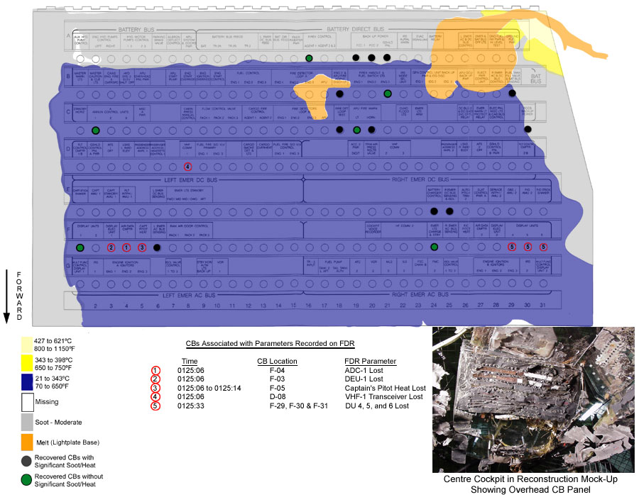
Investigation: Fire Damage
“The fire spread and intensified rapidly to the extent that it degraded aircraft systems and the cockpit environment, and ultimately led to the loss of control of the aircraft.”

Slide 25
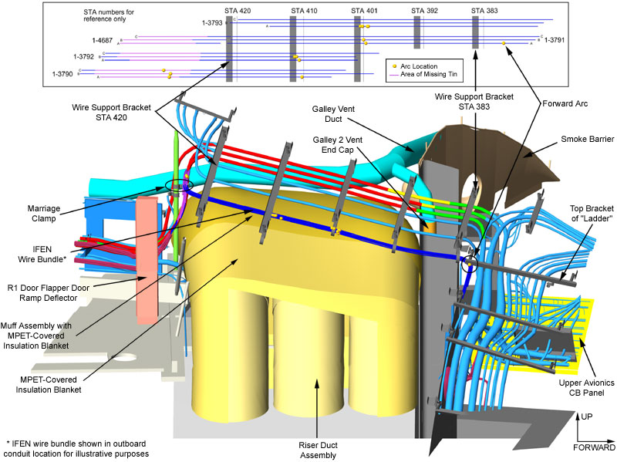
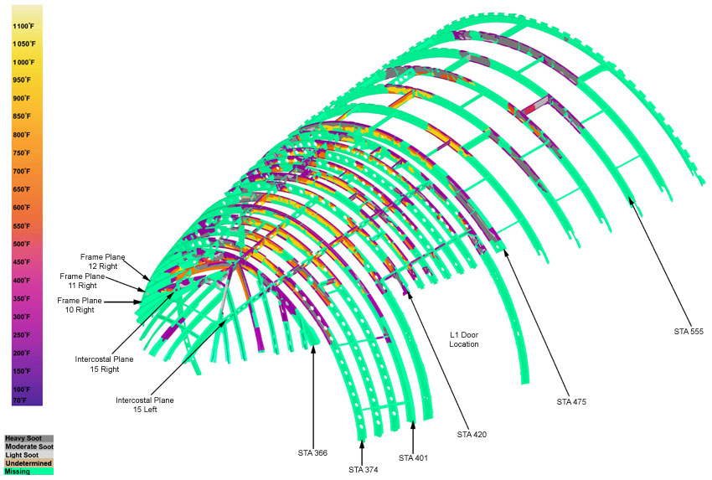
Investigation: Fire Damage
“Metallized polyethylene terephthalate (MPET)–type cover material on the thermal acoustic insulation blankets used in the aircraft was flammable.”
MPET ignited as a result of exposure to electrical arcing
Spark temperature could be as high as 500 °C
MPET tested for flammability by exposing to sparks. Occasional ignitions tripped CB

Slide 26
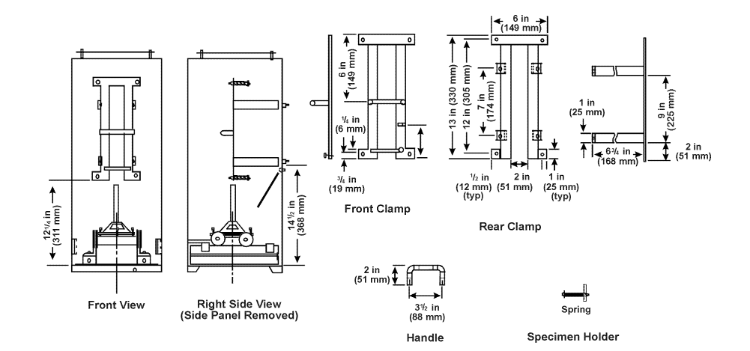
Investigation: Fire Damage
Side Note: Flammability Testing
Cabin materials are tested with a vertical Bunsen burner test.
Ignition time: exposure to a burner for 12 or 60 seconds
Flame time: time of continued flame after ignition cannot exceed 15 seconds
Drip flame time: time of continued flame for any material that collapses from specimen cannot exceed 3 seconds for the 60 second test and 5 seconds for 12 second test
Burn length: length of original specimen that exhibits burn damage cannot exceed 6 inches for 60 second test or 8 inches for 12 second test

Slide 27
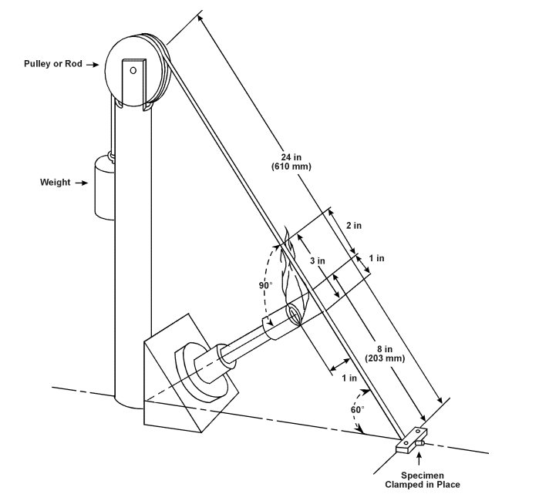
Investigation: Fire Damage
Side Note: Flammability Testing
Wires are tested with a 60 degree Bunsen burner test.
Ignition time: exposure to a burner for 30 or 60 seconds
Extinguish time: flame must be extinguished in 30 seconds or less
Drip extinguish time: any flames on material collapsed from specimen must be extinguished in no more than 3 seconds
Burn length: length of original specimen that exhibits burn damage cannot exceed 3 inches
Wire is allowed to break during test

Slide 28
Investigation: Tying It All Together
A failure of the IFEN PSU caused an electric arc in IFEN’s wiring above the cockpit
Electrical arcing ignited the MPET insulation blanket, made of a flammable material
Flammable materials caused the fire to propagate, causing additional electrical failures
Location of fire caused pilots to misdiagnose its origin as the air conditioner
Circuit breakers unable to handle thermal and electrical loads from arcing
Pilots fooled by electrical failure into believing engine was on fire, prompting cutoff of engine 2
Regulations did not require fire detecting nor suppression methods in the above cockpit area
Regulations did not require an active in-flight firefighting plan, rather, a method to make emergency landing
Fire disabled displays and inhibited cockpit accessibility, impeding the pilots’ spatial orientation, and ultimately led to destruction of the cockpit and loss of control of the aircraft
“It is evident that even if the pilots had attempted a minimum-time emergency diversion starting at 0114:18, it would have been impossible for the pilots to continue maintaining control of the aircraft for the amount of time necessary to reach the airport and complete a safe landing.”

Slide 29
Response
The FAA immediately introduces several Airworthiness Directives specific to the MD-11 and other Boeing models
AD 2000-11-02: All MPET insulation blankets removed from DC-10 and MD-11 aircraft
AD 99-20-08: Revocation of approval to install IFEN systems of same type certification (STC ST00236LA-D)
AD 2008-23-09: All insulation blankets composed of PET film or Orcofilm AN-26 on any aircraft must be replaced by materials that pass flammability tests in 14 CFR 25.856(a)
Additional ADs to address similar issues in other aircraft
Removal of MPET blankets from aircraft, replacing with blankets of appropriate non-flammable material
Removal or deactivation of IFEN systems that cannot be isolated and starved of power in the event of unknown fire/smoke
IFEN systems must be modified to be able to be isolated and shut off in the event of smoke/fire, and instructions to cut off power to the IFEN system must be outlined in crew manual

Slide 30
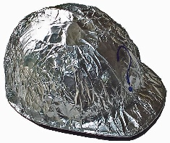
Is this the whole story?
http://www.cbc.ca/news/canada/swissair-crash-may-not-have-been-an-accident-ex-rcmp-1.1019738
In 2011, an ex-RCMP investigator claims that the fire aboard Swissair 111 was the result of an incendiary device.
High profile officials, including a Saudi prince, an envoy from U.N Secretary General Kofi Annan, and a relative of a former Iranian Shah
High value cargo, consisting of paintings and jewels
Evidence: elevated levels of magnesium in fire-damaged areas, heat levels too high for a conventional fire
TSB Investigation Report updated in 2012:
“The Royal Canadian Mounted Police found no evidence to support the involvement of any explosive or incendiary device, or other criminal act in the initiation of the in-flight fire.”

Slide 31
Sources
TSB investigation report A98H0003 http://www.tsb.gc.ca/eng/rapports-reports/aviation/1998/a98h0003/01report/
FAA Aviation Maintenance Technician Handbook – Airframe https://www.faa.gov/regulations_policies/handbooks_manuals/aircraft/amt_airframe_handbook/media/ama_Ch09.pdf
FAA Aircraft Materials Fire Test Handbook http://www.tc.faa.gov/its/worldpac/techrpt/ar00-12.pdf
http://lessonslearned.faa.gov/ll_main.cfm?TabID=4&LLID=22&LLTypeID=11
Aircraft Systems: Mechanical, Electrical, and Avionics Subsystems Integration 3rd ed., Ian Moir, Allan Seabridge (course textbook)
http://www.awcwire.com/productspec.aspx?id=mil-w-22759/16
https://en.wikipedia.org/wiki/American_wire_gauge
https://en.wikipedia.org/wiki/Swissair_Flight_111#Notable_victims

Slide 32
Questions and comments are more than welcome!
Contact Carson Haack
E-mail: cthaack@crimson.ua.edu
Office: M-12 Hardaway Hall
Thank you for enjoying this presentation!

